Slide 1
Discussion
Presented by Eduard Porosnicu, EUROCONTROL

Slide 2
Agenda
Lessons learned – open discussion with the objective to identify
Technical / operational issues to be addressed in the Digital NOTAM Specification (version 2.0)
Any input?

Slide 3
Agenda
Lessons learned – open discussion with the objective to identify
Any need for ‘generic training’, other than what is specific to the tool
Any input?
Glossary of terms that are relevant for Digital NOTAM – such as scenario, SAA, etc.
Transition phase – requires more knowledge about digital NOTAM concepts as compared to later phases when more advanced HMI will be available
For example, ability to read XML and understand what is right/wrong
Scope of each scenario – what is supported, what not?
For example, see https://ext.eurocontrol.int/aixm_confluence/display/public/DNOTAM/Commented+Digital+NOTAM+coding+example

Slide 4
Agenda
Brainstorming – how to encourage the Digital NOTAM implementations around the world
ICAO Annex 15 (16th edition) – “placeholder” for Digital NOTAM
ICAO/IMP – NOTAM revision plans
Digitally enhanced briefing concept (SESAR ePIB) as an end user application based on Digital NOTAM
Proposed actions

Slide 5
ICAO Annex 15 – 16th edition …and PANS-AIM (DOC 10066) – 1st edition
Digital data sets
AIP(en-route), instrument flight procedures, obstacle, airport mapping
5.3.2.3 The AIP data set shall contain the digital representation of aeronautical information of lasting character (permanent information and long duration temporary changes) essential to air navigation.
(PANS-AIM) 5.3.3.1.1, Note 2.— The AIP data set includes relevant AIP Amendment and SUPPs information.
6.3.3.2 Permanent changes and temporary changes of long duration (three months or longer) made available as digital data shall be issued in the form of a complete data set or a subset that includes only the differences from the previously issued complete data set.
6.3.3.4 Recommendation.— When temporary changes of short duration are made available as digital data (digital NOTAM), they should use the same aeronautical information model as the complete data set.
— END —

Slide 6
ICAO Information Management Panel
IMP “job cards”
NOTAM system revision
ICAO Proposal
New “AIM sub-group” under the IMP
NOTAM (system revision) Project
NOTAM revision – most common idea
Use digital data service for “planned events”
For example: temporary obstacle, THR change
Use NOTAM only for “last minute, unplanned events”
Where possible also provide digital data (for example – SNOWTAM)

Slide 7
EUROCONTROL - EAD evolution (eEAD)

Slide 8
Agenda
Brainstorming – how to encourage the Digital NOTAM implementations around the world
ICAO Annex 15 (16th edition) – “placeholder” for Digital NOTAM
ICAO/IMP – NOTAM revision plans
Digitally enhanced briefing concept (SESAR ePIB) as an end user application based on Digital NOTAM
Proposed actions

Slide 9
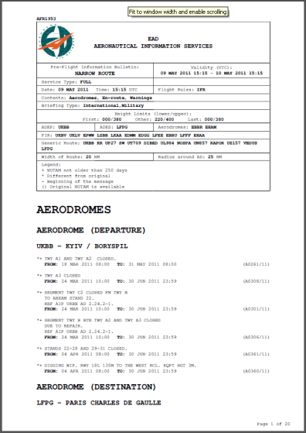
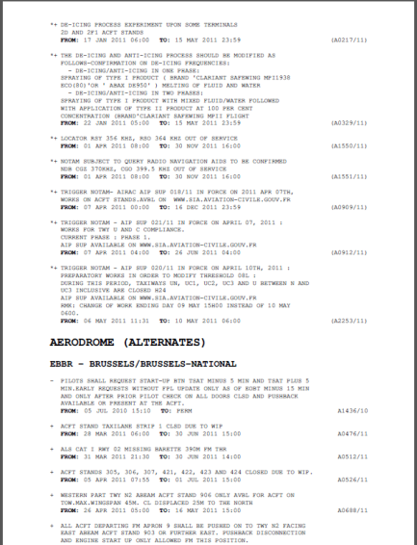
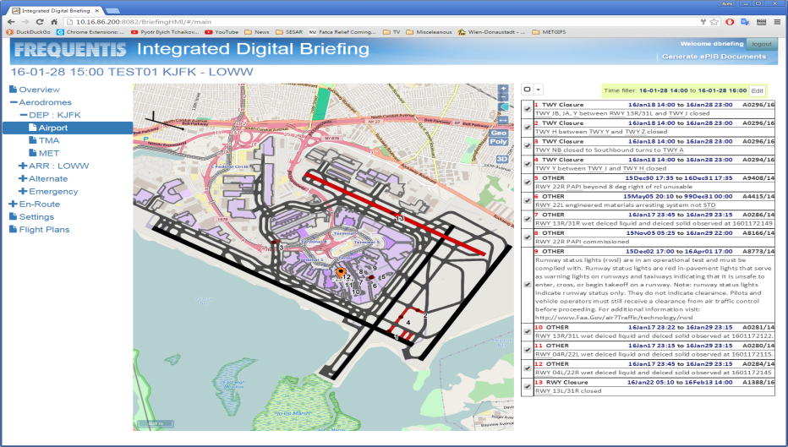
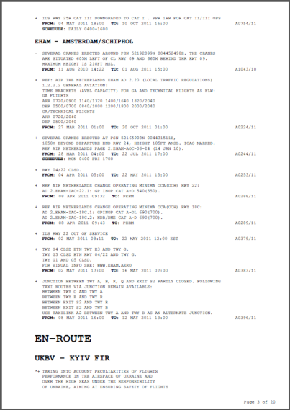
Digitally enhanced briefing (ePIB)
SESAR Project (“Solution #34”)

Slide 10
Digitally enhanced briefing (ePIB)

Slide 11
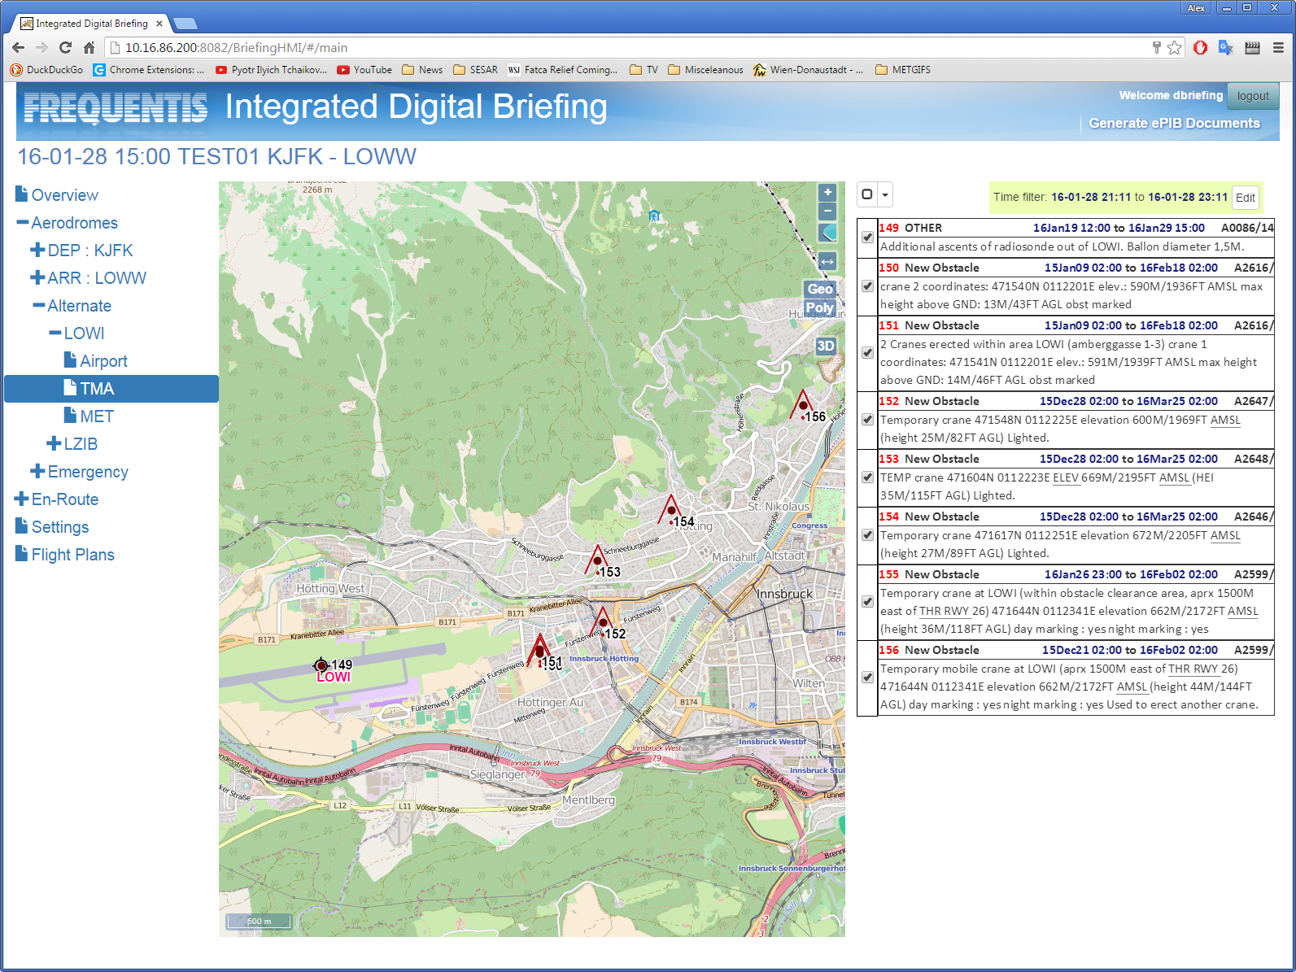
Digitally enhanced briefing (ePIB)

Slide 12
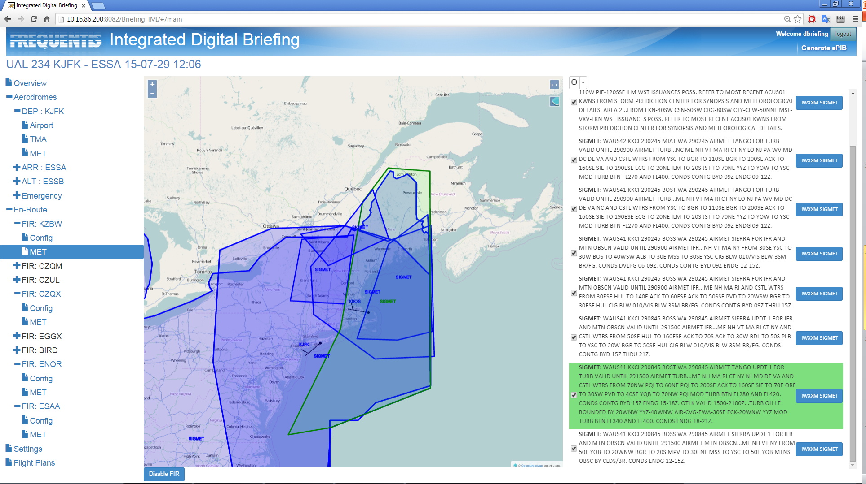
Digitally enhanced briefing (ePIB)

Slide 13
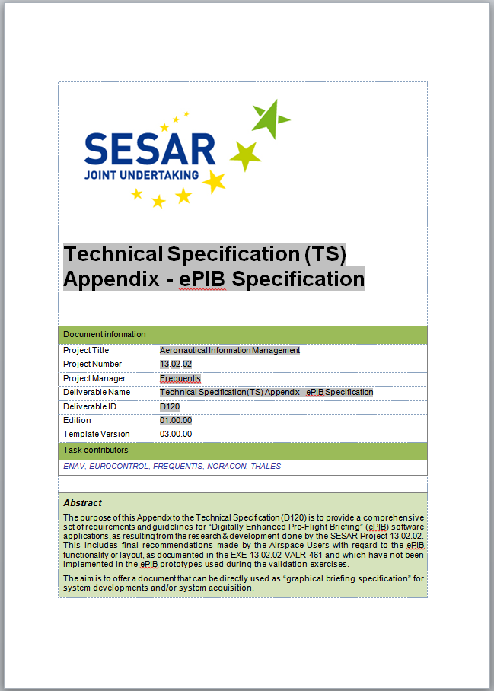
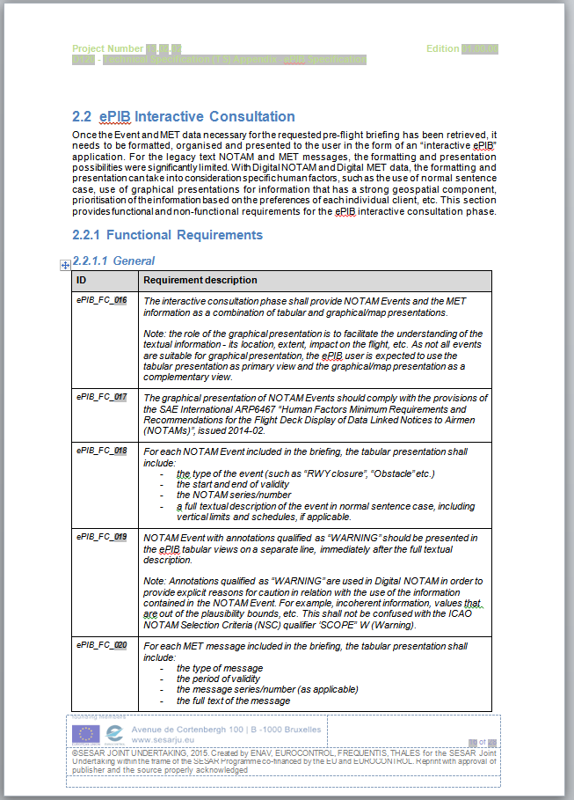
ePIB Specification

Slide 14
Initial ePIB implementations
Can be limited to aerodrome data
Require limited airport mapping data
… or limited to VFR data
current airspace situation
Can use a mix of NOTAM and Digital NOTAM
Non-digital NOTAM coded as “OTHER” events
Can be made available “for awareness”
Support by industry?

