Slide 1
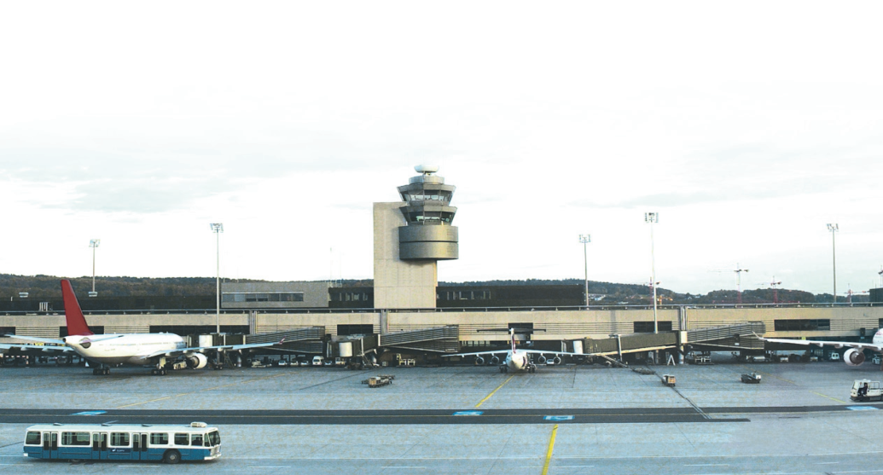
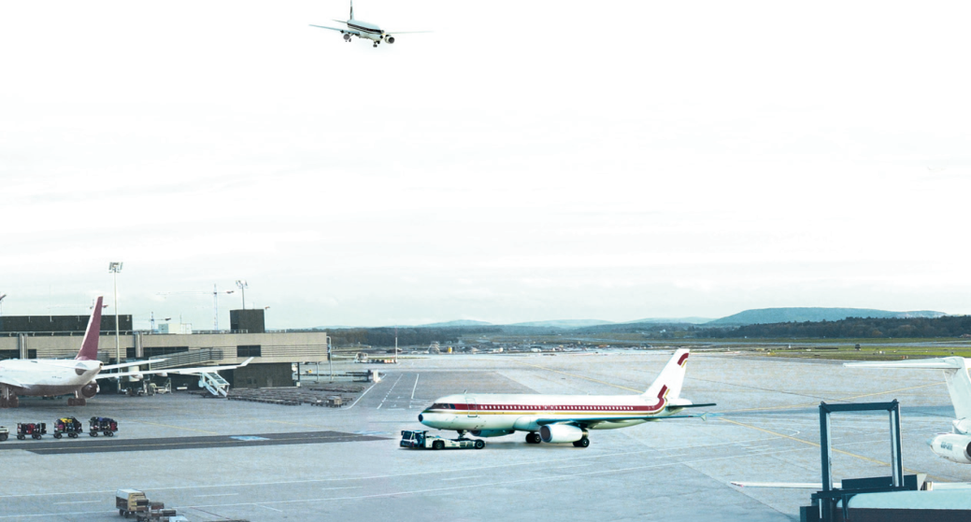
Avitech GmbH
Exchange Formats and Products
The Aeronautical Static Database (eSDO.Wiz@rd) &
The Aeronautical Exchange Layer (AxL)
Notes:
© 2002 Avitech Aviation Management Technologies GmbH
Author:

Slide 2
Avitech - Who are we?
Company
International
People from 16 nations
More the 30 Customers
30 Countries / 5 Continents
Military & Civil Customers
Services
Static, Obstacle, Terrain Data
Charting / AIP / FLIP
Training
Operational Concepts
Installation
Products/Systems
Aeronautical, Obstacle, Terrain Database System
NOTAM, OPMET, WAFS, Pilot Briefing (Airline, GA, all MIL)
Flight Plan Database System (ICAO, EU, NATO, USAR)
Mission Planning and ATM System Interfaces
SWIM Aeronautical Exchange Layer / Communication
Tower Information Management System

Slide 3
Current Functional Overview
Upstream
AIS
Downstream
ICAO PANS
OPS Doc
8168, 9368
FAA/DoD
TERPS
8260.3B
NATO
STANAG
3759
ICAO Annex
14/ Doc 9157,
9184, 9137
ICAO Annex
2, 11/
Doc 9613,
9689, 9574
ICAO Annex 4/
Doc 8697
ICAO Annex 15/
Doc 8126
ICAO AIS
Manual
Doc 8126
ICAO MET
Manual
Doc 8896
ICAO
PANS RAC
Doc 4444
Eurocontrol
IFPS &
CFMU/TACT
Manual
Eurocontrol
EAD
Procedures/
Slots
NATO STANAG
3970, 7005
ICAO 3-part AIP
RTCA
DO272A/
EUROCAE
ED99A
CENOR FLIP
Product SPEC
Eurocontrol
eAIP
Integrated Briefing
Procedures
Design
Aerodrome
Planning
Airspace
Planning
FLIP
MAP/Chart
AIP
NOTAM
OPMET/
WAFS
ICAO
IFPS/CFMU
FPL
INO
SDO
PAMS
Designed
Procedures
Mapped
Aerodromes
Separated
Airspaces/
Navaids
Static Data Procedures
NOTAM
Procedures
MET
Procedures
ICAO
IFPS/CFMU
FPL
Procedures
EAD
System
Interface
AIS Data Process
Avitech AXL 3.3.1 (XML) - AIXM XML 4.5/5.1
Topographic Data
Terrain Data
AICM 4.5/5.1 Data
(SDO/AIP/MAP)
Dynamic Data
(NTM/MET/FPL)
AIXM 4.5 (XML)
AD Mapping DB
Data Extensions
(Obstacle)
Data Extensions
(Aeronautical)
PAMS Data
AFTN/
AMHS
ARINC424
DAFIF 8
Other Downstream Systems
(e.g. Airlines, ATM, …)
Databases

Slide 4
Speaking the same language
Language and semantics as basis for communication
Sharing the syntax
AIXM 4.5/5.1,
WXXM,
FIXM,
AMXS,
ANXM,
NDBX,
…
Sharing the meaning
AIRM

Slide 5
Our Aeronautical Static Database (SDO)
Part of the Wiz@rd Suite
AIXM 5.1 compliant
Upload, Download, Update Messages,
AMDB Features AIXM 5.1++ (RTCA/EUROCAE),
Useable in Upstream environment (DO),
Useable in AIS/AIM environment (AIP, Charts, …),
Useable in Downstream environment (FLIP, radar charts)
Accessible through AxL,
Open architecture, relational DB.

Slide 6
AxL - Aeronautical Exchange Layer (SWIM)
System Wide Information Management Component
Multiplatform Support
Enterprise Service Bus (ESB)
Replication
Publish/Subscribe
Request/Reply
Service Oriented Architecture (SOA)
Seamless Service Location
Sharing of Services across the enterprise
Ability to separate Services from Service Implementation
Available Services
NOTAM, PIB, AFTN, ICAO/Eurocontrol FPL, AIP/FLIP, MAP, Static Data (AIXM4.5/5.1), AvXML (IWXXM), …

Slide 7
SWIM and AxL Scope (Fit to ATM Masterplan)
ATM-Specific
Non-ATM-Specific
Management of Information
Executive/ Strategic
Business Strategies
Operational/ Business
Conceptual Info Model (for business process modelling)
Process Model
AxL
Logical
ATM Information Reference Model
Application / Business Services
• • •
Aeronautical
Flight
Surv
Dmd&Cap
Architecture
e.g. bus times …
Information Services
meta
data
Technical/ Physical
Info Exchange Models (for implementations)
Systems and
Infrastructure
Middleware Services
Communications
© Eurocontrol
© Avitech GmbH

Slide 8
AxL Heritage – 5 Years of Success
Services/
Functions
Flexible Release Approach
3.3.0
3.4.0
2.4.2
3.0.0
3.1.0
3.2.0
2.2.5
2.3.0
2.4.0
2.4.1
2.2.2
2.2.3
2.2.4
2.0.6
2.1.0
2.2.0
1.0.9
1.0.10
1.1.0
t
2008
2009
2010
2011
2012
2013

Slide 9
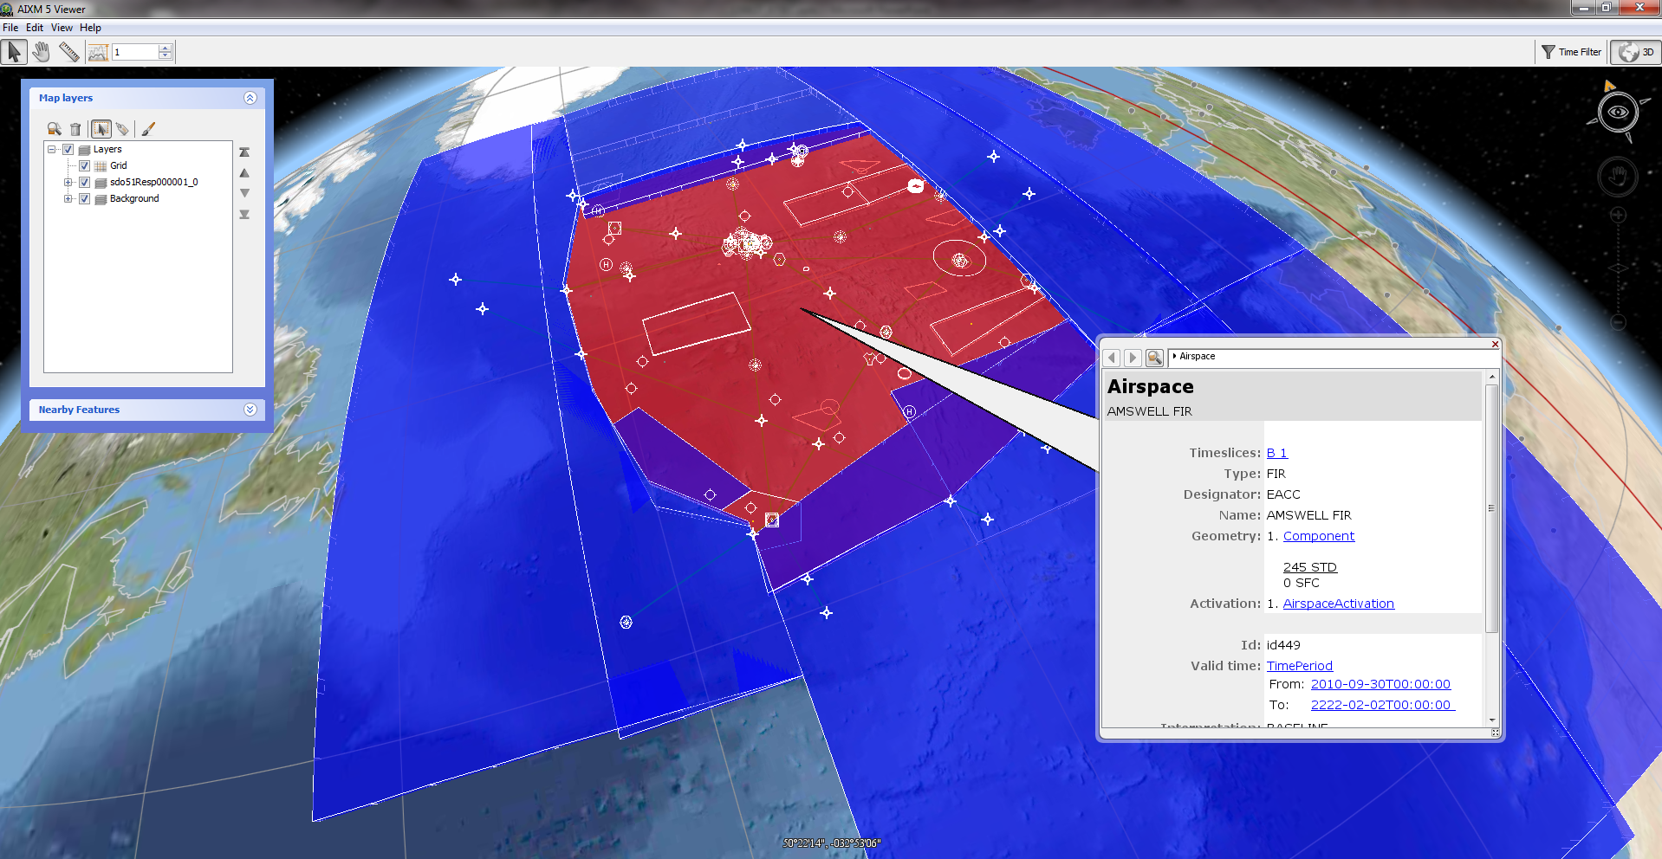
Standardization Benefits
AIXM5.1 + AxL + FAA AIXM5 Viewer

Slide 10
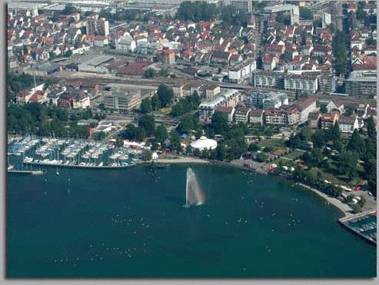
The Company Locations
Thank you for your attention!
Questions?
Frankfurt am Main
Contact
Avitech AG
Bahnhofplatz 1
D-88045 Friedrichshafen
Germany
Phone: +49-7541-282-0
Fax: +49-7541-282-199
www.avitech.aero
www.eaip.info
Friedrichshafen/Konstanz
Bratislava

