Slide 1
Overview of the AIXM 5.1 Procedure Model
AIXM Procedure Modelling/Encoding seminar
Brussels – 01/02 Sept 2010
Hubert LEPORI
Eurocontrol AIM Unit

Slide 2
Content
Context & History
Overview of the Procedure Model
Procedure Transition, SegmentLeg and SegmentPoint
Approach Conditions (minima…)
Circling Area
MSA
TAA
Miscellaneous
List of open questions

Slide 3
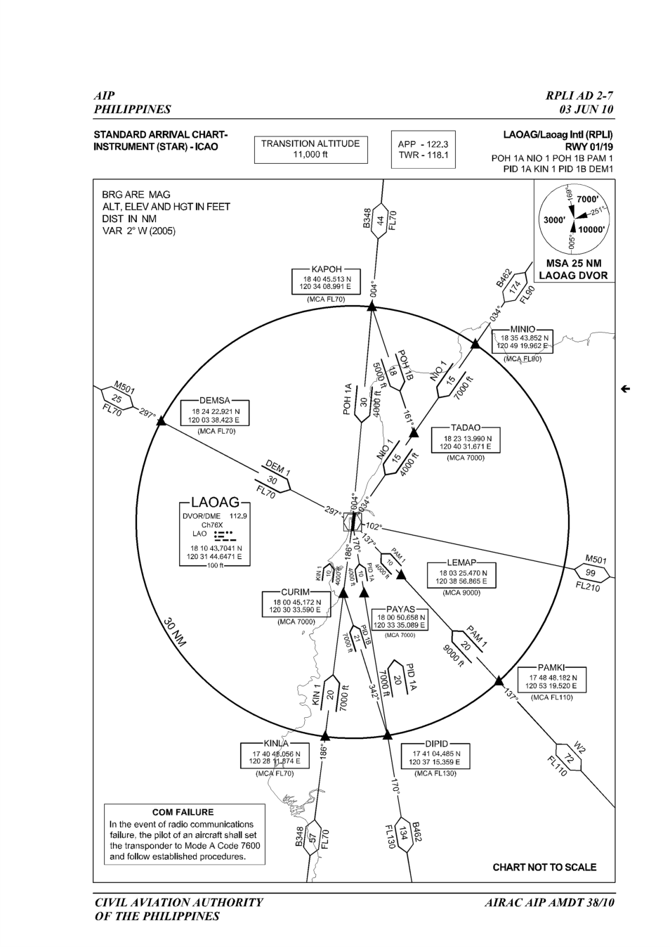
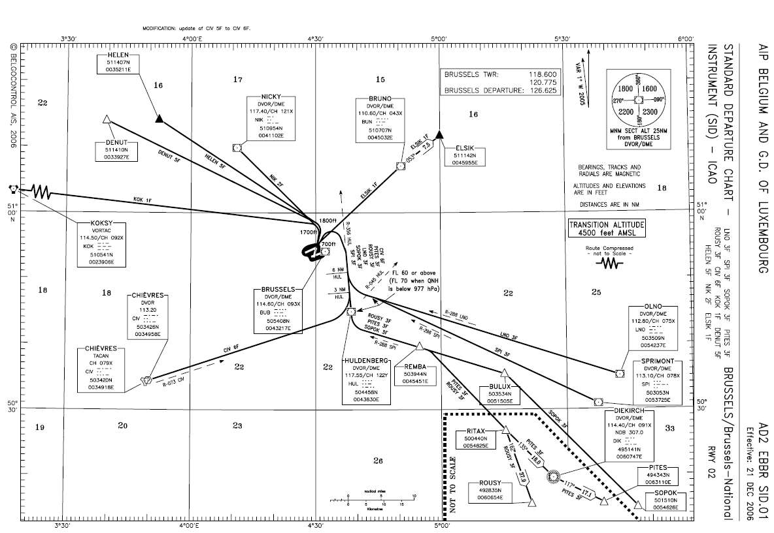
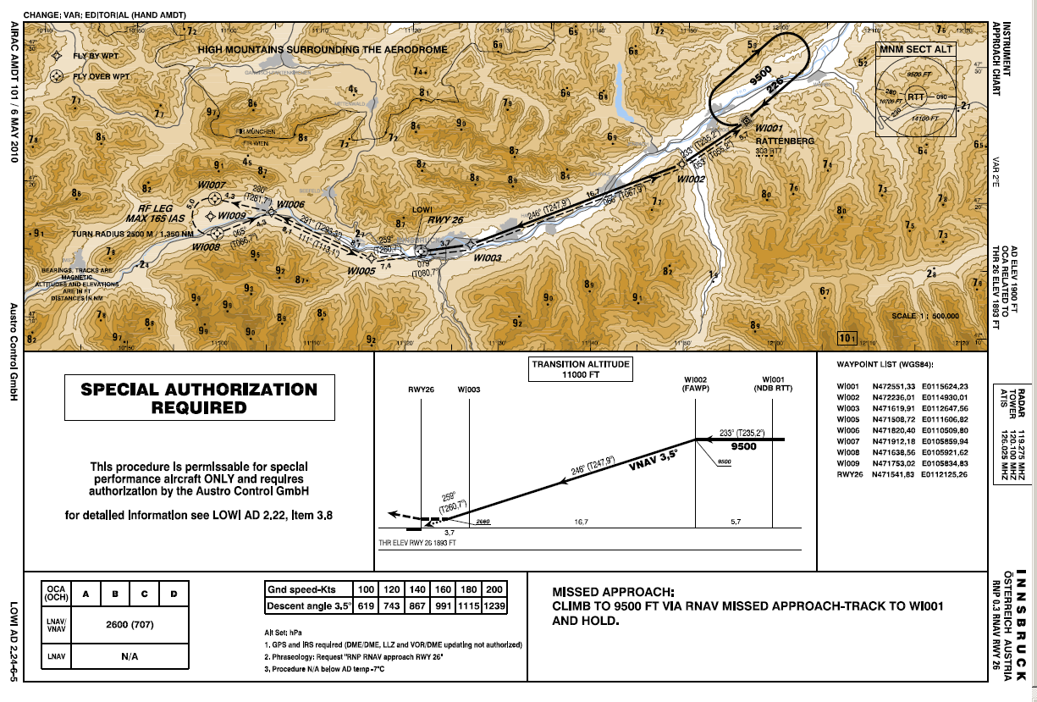
Procedure = SID, STAR or Approach

Slide 4
History of the AIXM Procedure Model
AIXM 3.3 / AIXM 4.5:
  Objective: provide an encoding for procedure charts, in support of EAD SDO
  Based on Arinc424-14
  ProcedureLeg was the key of the Procedure model
  Some non-Arinc legs (time-based legs PT/FT) were included

Slide 5
AIXM 4.5 Procedure Model

Slide 6
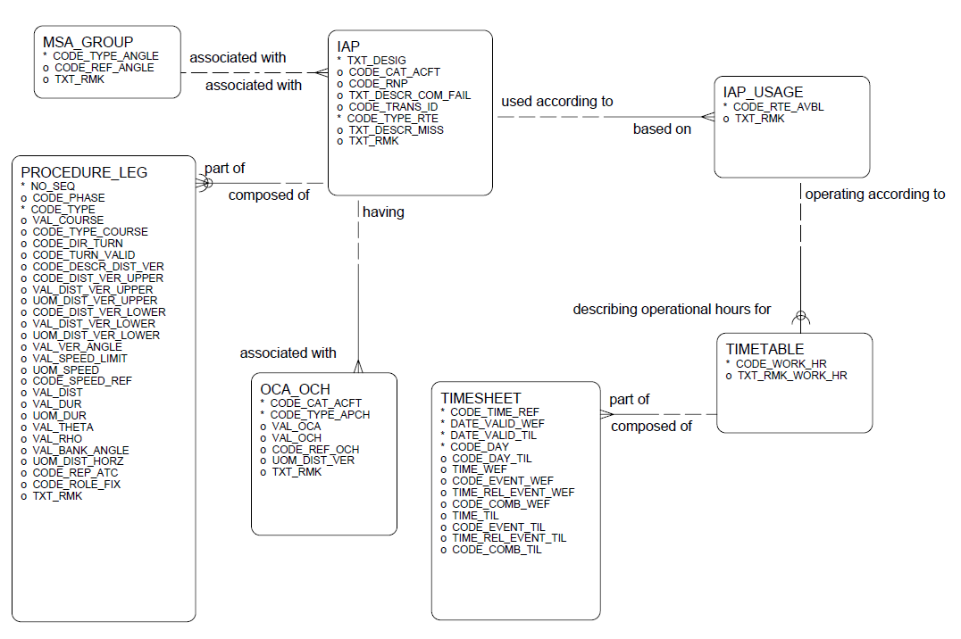
AIXM 4.5 Procedure Model

Slide 7
History of the Procedure Model
AIXM 5.0/5.1
  Better support the encoding of RNAV procedures published in AIPs
  Support the procedure design process
  Upgrade the model with recent changes in PANS-OPS and Arinc424 (FAS Datablock)

Slide 8
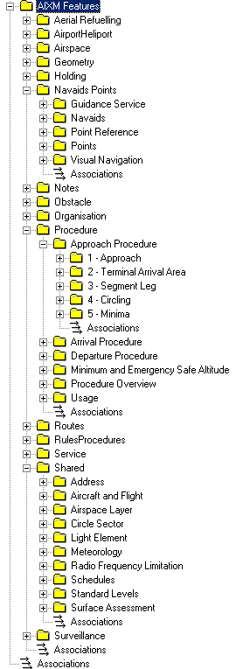
AIXM 5.1 Procedure Model - Overview
Procedure
The terminal area procedures and related concepts (MSA, TAA...)
Navaids Points
Guidance Service, Point Reference, and Segment Points
Holding
Holding Patterns
Service
For Information services (ATIS) and ATC services
Shared.Surface Assesment

Slide 9
AIXM 5.1 Procedure Model - Overview
Designator
SID & STAR: designator (+ name?)
Approach: name + 6 first attributes of class InstrumentApproachProcedure
approachPrefix = Blank
approachType = VOR
multipleIdentification = X
copterTrack = Blanck
circlingIdentification = Blank
courseReversalInstruction = Blank

Slide 10
AIXM 5.1 Procedure Model - Overview
Attribute RNAV is used to identify an RNAV procedure
For an approach, attribute approachType can also carry the value “RNAV”
Connection SID/STAR/Appr -> RunwayDirection is realised through class LandingTakeOffAreaCollection

Slide 11
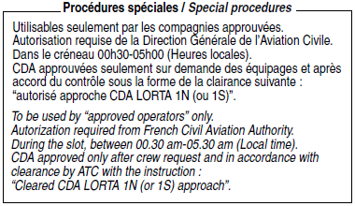
AIXM 5.1 Procedure Model - Overview

Slide 12
Procedure design vs Procedure encoding
The AIXM model defines the class SegmentLeg which represents an elementary portion of a Procedure
A SegmentLeg is associated to a Procedure. A procedure is designed by attaching several SegmentLeg to the procedure
A Procedure can be divided into a series of Procedure Transitions
More optimised for Procedure Encoding
Procedure
Design
Procedure
Encoding

Slide 13
Procedure Transition & SegmentLeg
IAF 1
WPT 1
WP 4
A Procedure can be divided in a series of Procedure Transitions
A Transition can be represented as a sequence of SegmentLeg
A Transition can be associated with a geographical Curve (for charting and procedure design - not intended for flight)
leg 1
leg 2
IAF 2
IF
FAF
MAP
leg 1
runway
WP 3
WP 2
3 “approach transitions”
1 final approach
1 missed approach

Slide 14





Procedure Transition & SegmentLeg
Approach Transition GEBTI
Approach Transition VFA
Final Approach
Missed Approach
SegmentLeg
HoldingPattern

Slide 15
SegmentLeg
SegmentLeg contains a set of attributes inspired from the Arinc424 specification
Note: It is not mandatory to use Arinc424 concepts => legPath
SegmentLeg is an abstract class which is specialised:
- 1st specialisation per type of procedure
- 2nd specialisation per type of transition for approach procedures
For a
SID
For a
STAR
For an
Approach
For a
missed approach
For an
approach transition
For a
final approach

Slide 16
SegmentLeg & SegmentPoint
InitialLeg 1
type = IF
InitialLeg 2
+ startPoint
type = CF
course = 276
courseType = MAG
+ endPoint
PointReference
role = RAD_DME
Angle/Distance Indication
angle = 96 (276-180)
angleType = MAG
distance = 9 NM
TerminalSegmentPoint
Navaid
Waypoint = NO
Indicator FACF = Yes
Designator = IIF
Role = IF
TerminalSegmentPoint
DesignatedPoint
Waypoint = YES
designator = GEBTI
type = ICAO
role = IAF

Slide 17

SegmentLeg - Particular cases
MissedApproachLeg
endConditionDesignator = ALTITUDE
lowerLimitAltitude = 2000 ft
MissedApproachLeg
endConditionDesignator = INTERCEPT
+distance
DistanceIndication
Navaid
distance = 18 NM
designator = TOU

Slide 18
Approach Conditions
ApproachCondition
finalApproachPath = STRAIGHT_IN
AircraftCharacteristics
aircraftLandingCategory = C
Minima
altitude = 218 ft
altitudeCode = OCA
altitudeReference = MSL
height = 200 ft
heightCode = OCH
heightReference = HAT

Slide 19
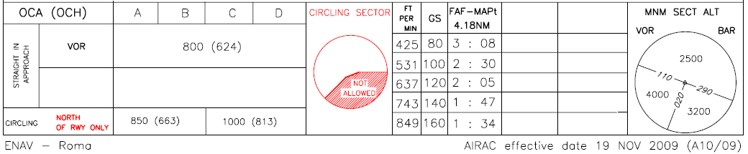
Circling Area

Slide 20
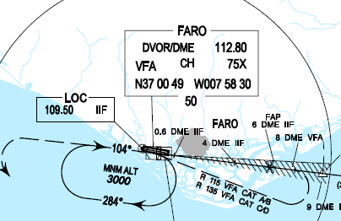


MSA
Navaid
Designator = VFA
+centrePoint
SafeAltitudeArea
safeAreaType = MSA
CircleSector 1
arcDirection = CWA (clockwise Arc)
fromAngle = 104
toAngle = 284
angleDirectionReference = TO
innerDistance = 0 NM
outerDistance = 25 NM
lowerLimit = 3000 ft
lowerLimitReference = MSL
CircleSector 2
arcDirection = CWA (clockwise Arc)
fromAngle = 284
toAngle = 104
angleDirectionReference = TO
innerDistance = 0 NM
outerDistance = 25 NM
lowerLimit = 1400 ft
lowerLimitReference = MSL

Slide 21
TAA
TerminalArrivalArea
safeAreaType = LEFT_BASE
+IF
DesignatedPoint
designator = LC406
+IAF
DesignatedPoint
CircleSector 1
designator = RIMOR
arcDirection = CWA (clockwise Arc)
fromAngle = 83
toAngle = 173
angleDirectionReference = TO
innerDistance = 15 NM
outerDistance = 25 NM
lowerLimit = 7100 ft
lowerLimitReference = MSL
CircleSector 2
arcDirection = CWA (clockwise Arc)
fromAngle = 83
toAngle = 173
angleDirectionReference = TO
innerDistance = 0 NM
outerDistance = 15 NM
lowerLimit = 5000 ft
lowerLimitReference = MSL

Slide 22
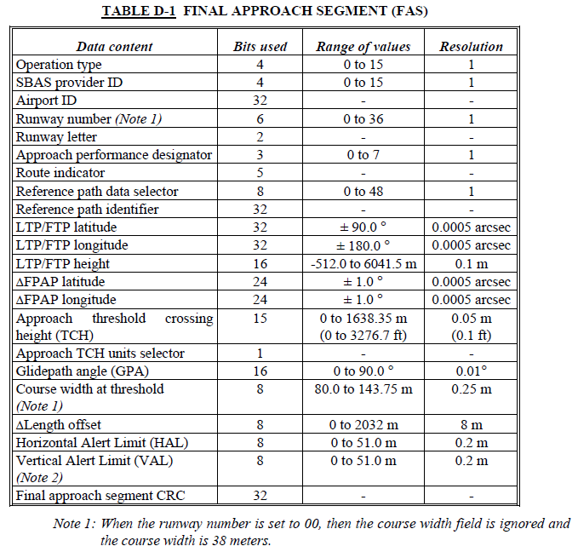
Miscellaneous - FAS datablock
The FAS data block is defined for RNAV GNSS approaches with LPV minima (SBAS)
FinalLeg
guidanceSystem = LPV
Note: The FAS DB can not be encoded as a whole (i.e. in one block) in AIXM 5.1 (E.g: AirportID)
Extracted from RTCA DO229-D

Slide 23
Open questions
Procedure Designator
  SID, STAR -> which attribute should be used by default: designator or name ?
    Proposed answer: Designator
  InstrumentApproachProcedure: Define an attribute designator ?
    Proposed answer: Not necessary
How to encode the A424 recommended Navaid of a SegmentLeg ?
  Proposed answer: use TerminalSegmentPoint/PointReference/…

Slide 24

Questions ?

