Slide 1
Digital NOTAM
Implementation @EANS

Slide 2
ICAO Text NOTAM
smartWFM
(Business Process)
CADAS-IMS
(ICAO Text NOTAM Mgm.)
Notes:
This slide shows the starting point of the project from a NOTAM perspective in Estonia.
For managing traditional ICAO Text NOTAMs EANS is already using our workflow management system smartWFM and our ICAO Text NOTAM mgm system CADAS-IMS.
SmartWFM controls ADQ compliant the complete business process for NOTAM creation, validation, verification and distribution. And provides also a NOTAM proposal form used by the data originators.
CADAS-IMS is our ICAO ext NOTAM Mgm. System. CADAS-IMS is connected with EAD and publishes the Text NOTAMs towards EAD.

Slide 3
System Design Digital NOTAM
smartWFM
(Business Process)
GIS Viewer
CADAS-AIMDB HMI
(scenario based AIXM 5 masks)
CADAS-AIMDB
(AIXM 5 DB)
CADAS-IMS
(ICAO Text NOTAM Mgm.)
Notes:
As long as the digital NOTAM specification does not capture all necessary use cases and as long as the world is mainly based on ICAO text NOTAMs, the single source of NOTAM truth will be right now still a Text NOTAM system and the new digital NOTAM functions needs to be integrated somehow with the existing database.
To capture static data, EANS is using since several years our AIXM 5 database CADAS-AIMDB. This two systems builds the foundation of the digital NOTAM system: digital NOTAM are stored in AIMDB, the text representation in IMS.
As a starting point we agreed with EANS to implement the two scenarios SAA.ACT and SAA.NEW. This requires an improvement of the overall business process. The business process decides, based on the originators NOTAM proposal, if the NOTAM has to be captured as digital NOTAM or still as a Text NOTAM.
Last but not least, our scenario (or use case) based AIXM 5 HMI incl. our GIS viewer is used for the digital NOTAM masks.
In a nutshell, the project reuses already established COTS products with some generic improvements necessary for digital NOTAM (like NOTAM converter).
The following slides will give you an overview of the components needed for digital NOTAMs.

Slide 4
Component 1: AIXM 5.1 Database (CADAS-AIMDB)
Native AIXM 5.1 database
Full support for temporality as defined in AIXM 5.1
    Data fusion of static and dynamic data
Web-based user interface
Business Rules Engine for data validation and consistency checks
Open Interfaces
AIXM 4.5 and ARINC 424 support
EUROCONTROL compliant static data procedures
Support for Work Packages
EAD connection
  Adaptable database schema ⟹ Support for extensions and non-AIXM data
  Fine-grained access control
USPs
Native AIXM 5 database
Full support for temporality
AIXM 4.5 and ARINC 424 support
Open interfaces
PostgreSQL and Oracle support
Adaptable database schema
Light-weight
15 customers worldwide
Notes:
CADAS-AIMDB is our AIXM 5 database. CADAS-AIMDB is a native AIXM 5 database, i.e. it fully supports AIXM 5.1 (all feature types, all attributes), the AIXM 5 temporality, and therefore the data fusion of static and dynamic data. With the web based user interface and the business rule engine for any kind of data the database is a perfect foundation for a digital NOTAM system. Without significant improvements.

Slide 5
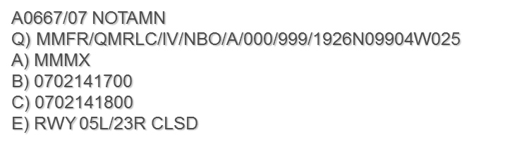
Component 2: Workflow Management
<?xml version="1.0" encoding="UTF-8"?><aixm-message:AIXMBasicMessage xmlns:aixm-message="http://www.aixm.aero/schema/5.1/message" xmlns:gml="http://www.opengis.net/gml/3.2" gml:id="gmlID807">
<aixm-message:hasMember>
<aixm:Airspace xmlns:aixm="http://www.aixm.aero/schema/5.1" gml:id="gmlID808">
<gml:identifier codeSpace="urn:uuid:">54bef6d0-de7c-4b5d-b38d-6a4d6aa7160d</gml:identifier>
<aixm:timeSlice>
<aixm:AirspaceTimeSlice gml:id="gmlID809">
<gml:validTime>
<gml:TimePeriod gml:id="gmlID810">
<gml:beginPosition>2018-01-31T00:00:00.000Z</gml:beginPosition>
@
@
@
Notes:
The second component is the workflow management system. As both NOTAM types will be issued in parallel (at least for many years) an automatic generation of the classical NOTAM is needed to avoid its manual creation on a separate system.

Slide 6
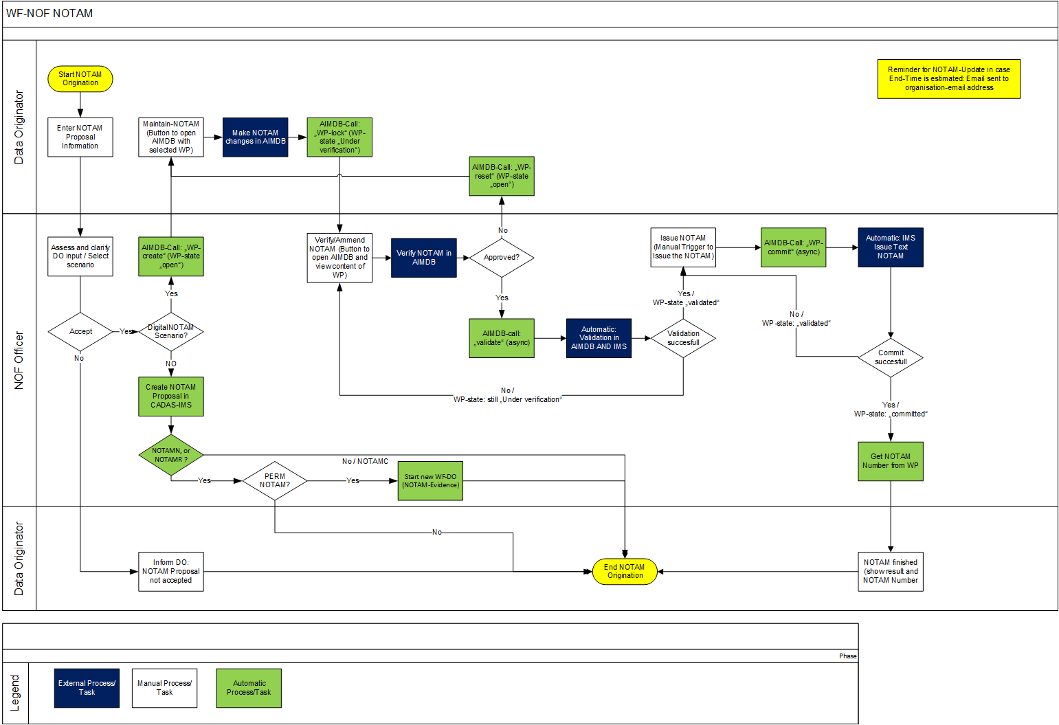
Component 2: Digital NOTAM Workflow
Notes:
Here you see the new NOTAM workflow in Estonia. The colored boxes and the rhombuses are automated steps. Only the white rectangles are manual steps. The data originator enters some NOTAM proposal information into an already existing form. If the NOF officer accepts the proposal, then the system decides if the workflow shall proceed with the new digital Path or the existing traditional path. In the case of a DNOTAM scenario, the system redirects the request back to the originator. The originator enters the NOTAM information directly into the digital NOTAM mask. After validation and verification of the digital NOTAM, the text NOTAM will be validated in IMS and EAD and if everything is fine, then the digital NOTAM takes also over the assigned NOTAM number to ensure the tracebility. Through this approach a smooth transition can be achieved. scenario for scenario can be established without big bang.

Slide 7
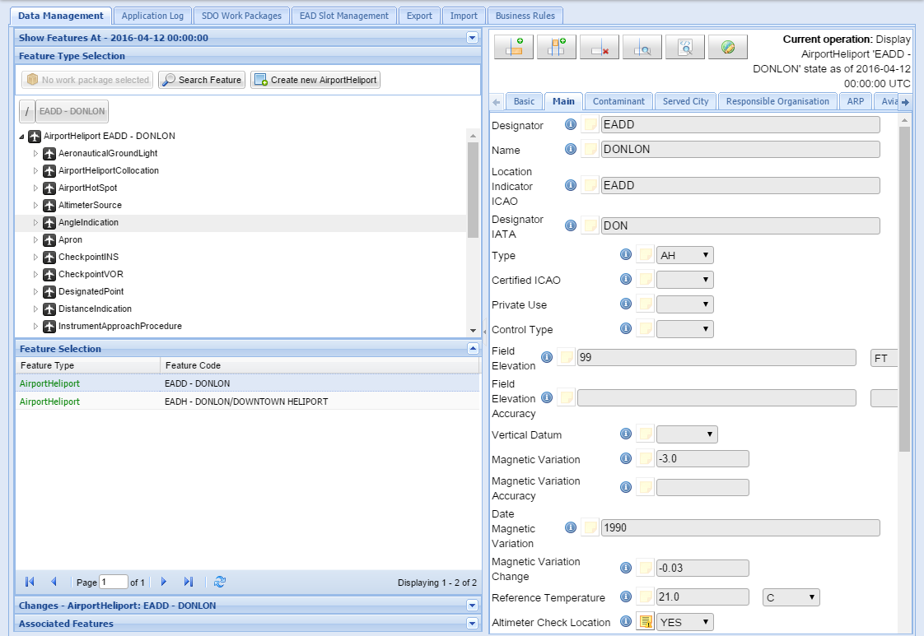
Component 3: User Interface for Digital NOTAM Scenarios
Fully-fledged AIXM 5.1 user interface
=> overwhelming for NOTAM purposes
?!?
Notes:
From an AIXM 5 perspective the biggest challenge is the HMI. A fully-fledged AIXM 5.1 user interface is for sure not usable for digital NOTAM scenarios. Such an HMI is overwhelming the user for NOTAM purposes.

Slide 8
Component 3: User Interface for Digital NOTAM Scenarios
Problem: A fully-fledged AIXM 5.1 user interface shows the technical perspective instead of the business perspective.
Goal: Decoupling of data input forms from AIXM 5.1 schema
Benefits: Easier use, reduced complexity
Examples for Use-Case based Input Forms:
  Digital NOTAM Scenarios
  AIP Data Sets
  Route Editor
  Airspace Editor
  Procedure Editor
Notes:
One goal of the previous project with EANS was to decouple the data input forms from the AIXM 5.1 schema and temporality to support use case based masks and to reduce the complexity for the user. Each digital NOTAM scenario will be a use case based input form. Other examples for such input forms are AIP data sets, route editor, airspace editor or other use cases.

Slide 9
Component 3: User Interface for Digital NOTAM Scenarios
Ability to display and freely arrange attributes of a feature
Ability to display attributes of several feature types on one screen
Temporality aspects are hidden as far as possible from the user, e.g.
  Use of PERM or TEMP for new deltas
  Use of correction if PERM/TEMP for the effective date already exists
Interface definition is configuration (no need to re-compile)
Interface definition could even be done by the customer (with proper training)
Different UI configurations in one system are supported. The UI configuration can be defined per user role.
Ability to consider potential local encoding rules
Notes:
Use cases supports the ability …

Slide 10
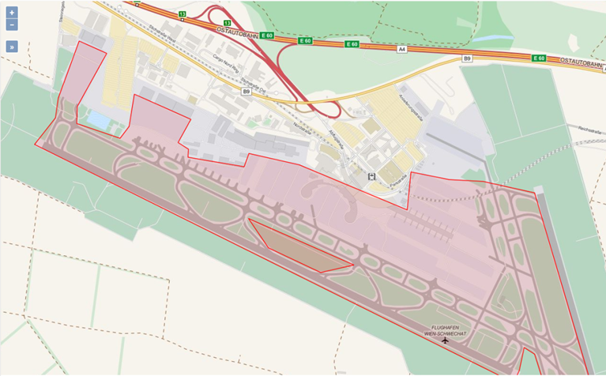
Component 3: GIS Viewer
In-Line Graphical Viewer
Interoperability with other GIS sources
Based on open source
and COTS components
Display of AIXM data as
layers on top of a back-
ground layer (e.g. OSM,
satellite imagery, etc.)
Notes:
CADAS-AIMDB HMI provides also an in-line graphical GIS viewer that shows all geospatial information available within the AIXM 5.1 data model. Throug open standardized web interfaces additional layer beyond AIXM 5.1 can be added.

Slide 11
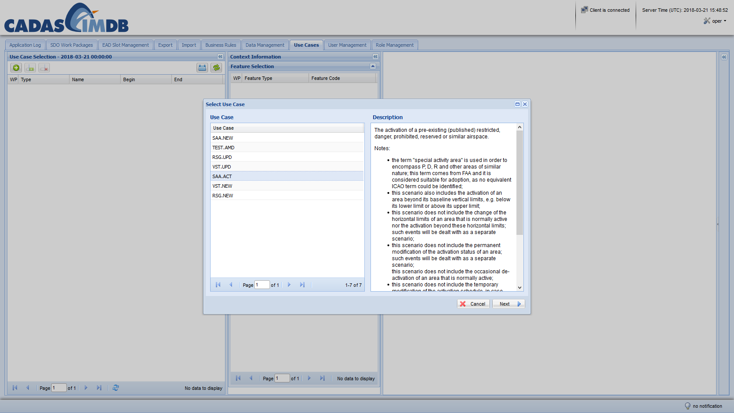
Component 3: User Interface for Digital NOTAM Scenarios
Notes:
How to create a Digital NOTAM with CADAS-AIMDB HMI: The user selects first the scenario. Here SAA.ACT. On the right panel you can see a configurable online help. If the user selects SAA.ACT, which will activate a published special activity area, then ….

Slide 12
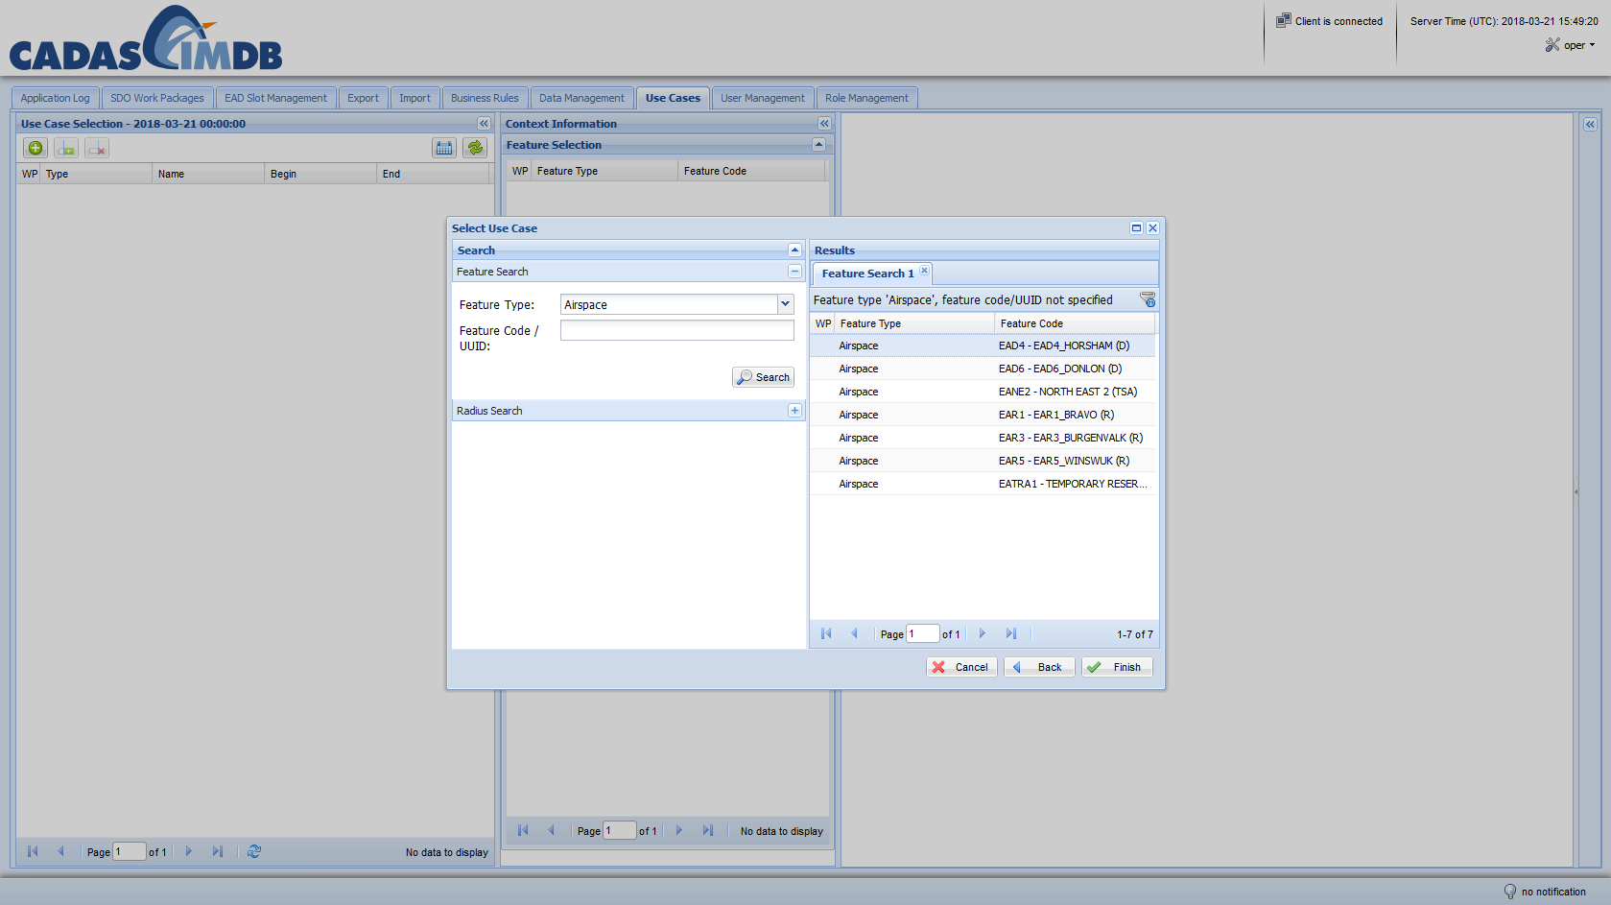
Component 3: User Interface for Digital NOTAM Scenarios
Notes:
… the user can search and select one of the published SAAs. According to the event spec the HMI creates for this use case a new TEMPDELTA for the selected airspace. If the user selects SAA.NEW as use case, then this widget will not appear.

Slide 13
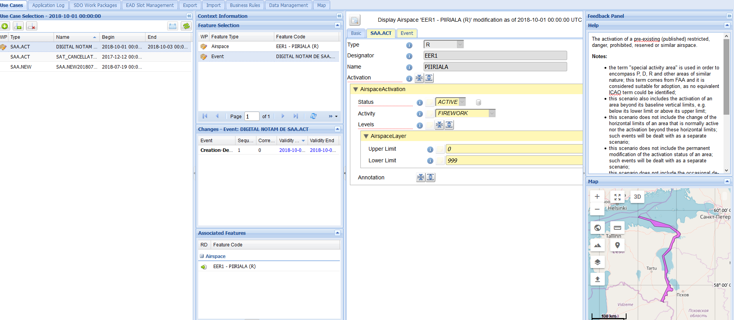
Component 3: User Interface for Digital NOTAM Scenarios
Notes:
Here you can see a screenshot of the use case masks SAA.ACT. The panel on the left lists all effective digital NOTAMs. The second panel provides additional context information, like involved AIXM 5.1 features, time slice history and the associated AIXM 5.1 features.
The third panel shows one possible configuration of the digital NOTAM mask for SAA.ACT. The first three atrributes are read only and presents the information of the underlying BASELINE. The user can double check that the correct airspace was selected. The Status is set per default to ACTIVE. The proprties presented in yellow shows the changes made by the system or by the user (compared to the underlying BASELINE). All other properties of an Airspace are hidden.The panel on the right side is the feedback panel with the online help and the GIS viewer. Not shown here in the screenshot is the resulting text NOTAM which will be also represented here. Also not shown here is the UI to capture AIXM 5.1 compliant schedules.

Slide 14
In a nutshell: Digital NOTAM implementation
Digital NOTAM can be issued in parallel with the current NOTAM messages.
Use case (scenario) based input forms hide the complexity of the AIXM data model.
Support of the Digital NOTAM workflow including creation, verification, validation, and issuing.
Automatic creation of the traditional ICAO text NOTAM for supported scenarios.
Integration of legacy systems to handle traditional ICAO text NOTAM .
Visualization of changes directly in the application.
New scenarios can be added by configuration.
Notes:
In a nutshell:
- Digital NOTAM can be issued in parallel with text NOTAMs
- Use case based masks hides the AIXM complexity.
Digital NOTAM system can be integrated with other legacy systems to handle ICAO Text NOTAM
New scenarios can be added by configuration without redeploying software. Same for other necessary adjustments.

Slide 15
Markus.Haas@frequentis.com

