Slide 1

Delivering Digital
Services
FIXM -
Flight Information Exchange Model
Presented By: Rob Hunt
      Manager, FAA,
      Air Traffic Organization,
      Technical Analysis & Operational Requirements Group
Date: August 26, 2014

Slide 2
Background – Why are we here…
Problems
Inconsistent and redundant flight information/data exists
Lack of global harmonization/standardization and update constraints (ICAO 2012)
Increasing information requirements (FF-ICE, PBN, UAS, user preferences, etc.)
Solution – Flight Information Exchange Model (FIXM)
A common, global data interchange format for sharing information about flights throughout their lifecycle
Uses current technology (XML)
  Not text-based
  Machine-to-machine understandable, consistent with AIXM and WXXM
  Supports versioning and avoids global “Big Bang” change requirement
1

Slide 3
Congratulations!
Release of FIXM Version 3.0
4D Trajectory
Surface Operations
2

Slide 4
FIXM Governance
FIXM CCB welcomed new members
  DSNA (Direction des Services de la navigation aérienne)
  IATA (International Air Transport Association)
FIXM CCB has finalized and published
  FIXM Strategy document
  FIXM Change Management Charter
  Globally Unique Flight Identifier (GUFI) Requirements & Format
  ATS Message Content to FIXM Logical Model Map
3

Slide 5












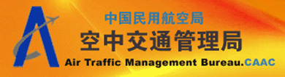




FIXM Participants
FAA
DOT
DOD
Others in future…
4

Slide 6
Who’s using FIXM?
Mini-Global demonstrations (FAA)
FDPS (Flight Data Publication Services) (FAA)
ODS (Operational Data Services) (Airservices Australia)
ICATS (Interoperability Cross Atlantic TrialS) (SESAR)
Jumpstart (EUROCONTROL)
Airport CDM extension (EUROCONTROL)
OGC - OWS-10 (FAA, EUROCONTROL, OGC)
5

Slide 7
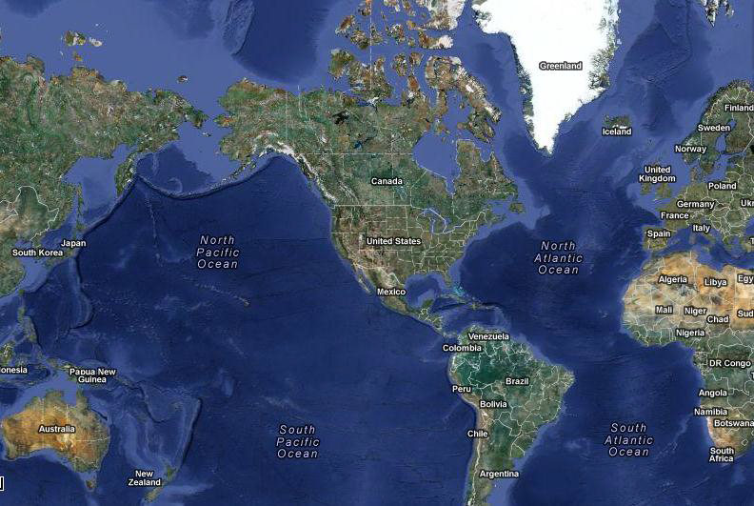
This year…
FIXM Version 4.0
  4D Trajectory – 2nd Package
Mini Global Demonstration
  Demonstrate the applicability of the global exchange models for Flight, Aeronautical and Weather information using the FIXM, AIXM, and WXXM
  Demonstrate how ANSPs and Operators, in both the Pacific and Atlantic regions, are able to share common information to:
    Improve collaborative decision making (CDM)
    Improve air traffic management (ATM)
    Promote international harmonization
6

Slide 8
Looking forward…
FIXM Release | Release Date | Release Contents
1.0 | Aug 2012 (completed) | ICAO 2012 ATS – FPL message GUFI (Globally Unique Flight Identifier) NAS Flight Plan Data Initial ED-133 Element inclusion
1.1 | Dec 2012 (completed) | Dangerous Goods
2.0 | Aug 2013 (completed) | ICAO 2012 ATS (15 remaining messages) ICAO 2012 AIDC messages TFM (Strategic) TFM Data Exchange ANSP-Airline CDM Fleet Prioritization Airport CDM ANSP-ANSP boundary crossing
3.0 | Aug 2014 (completed) | Surface data 4D Trajectories (1st package)
4.0 | Feb 2016 (pending CCB approval) | 4D Trajectories (2nd package)
7

Slide 9

Questions
8

