Slide 1
Delivering Digital
Services
Ontology/
Semantics
Theme
Presented By: Deborah Cowell,
FAA, AIT
Date: August 27, 2014

Slide 2
Business Challenges
What data/information do we have?
Where is it?
How can I find it?
How can I get to it?
How can I merge it with other information that I need to answer business questions? And…have the agility to add more sources in a timely manner?
How can I retrieve only the information that I need that is “relevant” to me, versus everything?
How can I extract value from paper-based forms/documents?

Slide 3
Technological Challenges
Integrating data and information from disparate sources (Variety); each using different schemas and models.
Coping with rapidly increasing volumes of data/content (Velocity & Volume).
Providing access to relevant, timely and reliable data (Veracity).
Delivering value to the information customers by providing agile methods, techniques and tools.
Providing the ability to ask questions extemporaneously.
Requires us all to undergo a new way of thinking!

Slide 4
Key Enabler: Semantic Technology
Semantic Technologies
Software systems built with algorithms that depend on machine-executable representations of real-world knowledge
Machine Understanding
Semantics provides machine interpretable context
Standards-based technologies enable knowledge at scale
Source: Securboration, Inc.

Slide 5
Ontology
Definitions
An ontology is a structured representation of the types of entities and relations existing in a given domain that is designed to support exchange and reuse of data and information.
Source: Securboration, Inc.

Slide 6
Ontology – Components
Classes
Collections of individuals
Ex: Airport, Runway, Infrastructure
Relations
Specification of how classes and individuals relate to one another
Ex: part of
Axioms
Categorical assertions
Ex: “Airports are infrastructure”, “No Airport is a runway”.
Individuals
Basic entities/instances which get classified
Ex: IAD, 01C/19C
Infrastructure
is a
Ontology
Airport
disjoint
with
Runway
type
type
part of
01C/19C
Data
IAD
Source: Securboration, Inc.

Slide 7
Ontology Architecture: A Tiered Approach
Ontology Levels
Upper Level - A small, highly curated and stable ontology that describes
very general concepts (e.g. Entity, Event) that are the same across all knowledge domains.
Mid Level – A high level domain ontology that provides
A bridge between an upper-level ontology and numerous low level domain ontology
E.g.: Aviation Ontology
Lower Level - A low level domain ontology that describes
A very specific area of a domain
E.g.: Phase of Flight Ontology is a lower level Aviation Ontology
Source: Securboration, Inc.

Slide 8
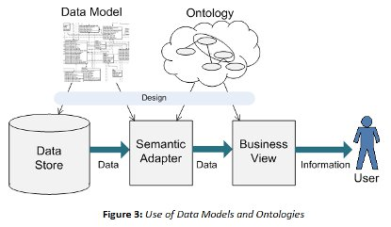
Relationship to the Data Models
By Malcolm Chisholm, AUG 12, 2014 Information Management

Slide 9
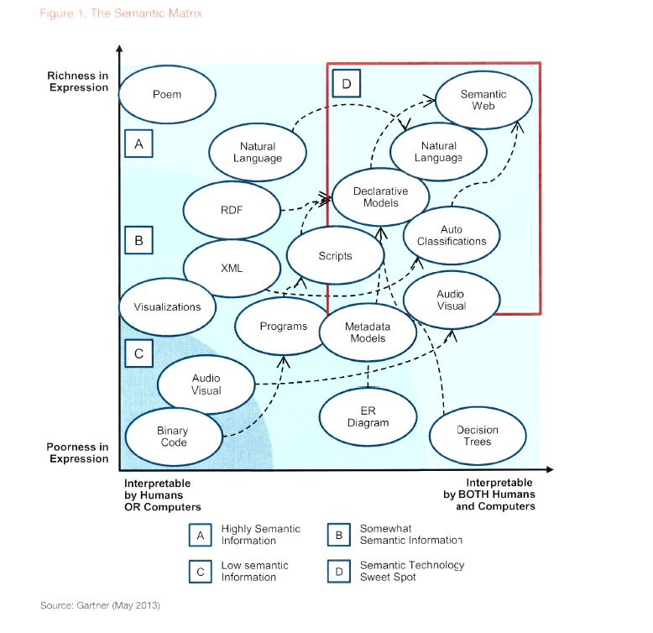

Slide 10
Our Speakers Today…
Josh Powers
Wen Zhu (Demo)
Eduard Gringinger

