Slide 1

Cross-Organizational Semantic Services
Interagency Net-Centric Operations
4/4/14
Cross-Organizational Semantic Services
Interagency Net-Centric Operations
8/27/14

Slide 2
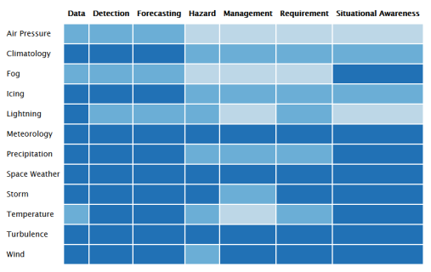




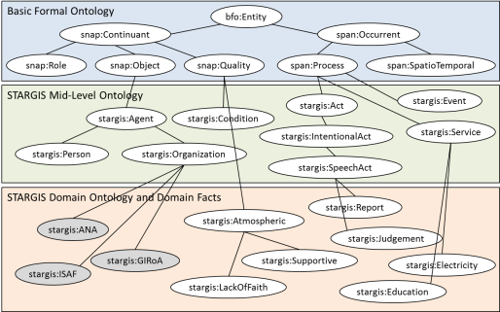
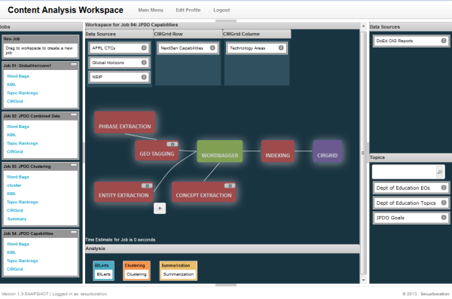
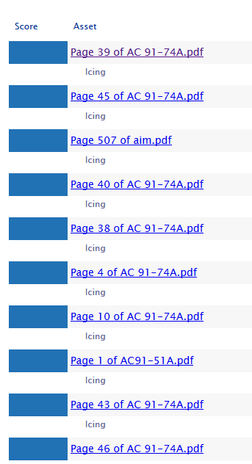
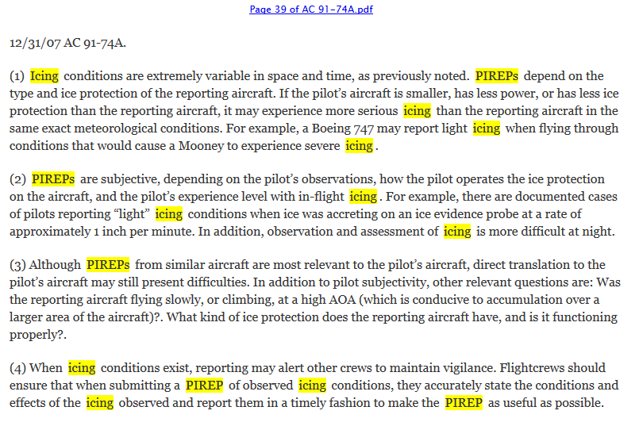
CrOSS Informs Decision Making
Critical Information Requirement
<xml</>
Dataset Harvesting
Better
Decisions
Dashboard
Domain Modeling
Big Data Analytics
Organize -> Navigate -> Understand -> Decide
Situational Awareness

Slide 3
CrOSS Information Analysis Services
CrOSS Automates:
  Tagging of data with domain-relevant vocabulary
  Organizing datasets for relevance ranking and navigation
  Extracting specific information from large volumes of text
  Delivering decision support information to knowledge workers

Slide 4
CrOSS Example Use Cases
Bird Strike coverage in Federal Aviation Regulations (FARs)
Technical Certification Data Sheet Analysis
Weather Requirements in CONOPS

Slide 5
Use Case 1: Bird Strike Coverage in FARs
When an aviation incident occurs, find all Federal Aviation Regulations (FAR) which are relevant to the specifics of the incident
  Specifically for this demo and validation: Find FARs which deal with bird strike issues
Organize FARs with respect to aviation topics such as Airframe, Engine, Testing, etc.
Scale:
  6530 regulatory sections
  13 Topics of interest

Slide 6
CrOSS Approach
Create FAR data source from XML batch data
  Split into individual assets
  Collect metadata – section no, title, etc.
Model Topics of interest in ontology
  Create Classes, Properties for aviation
  Link to natural language expressions
  Convert to Securboration Topics
Process data source against Topics
  Rank FARs and extraction results against Topics
Visualize Results
  Grid-style Crosswalk
  XML Metadata

Slide 7
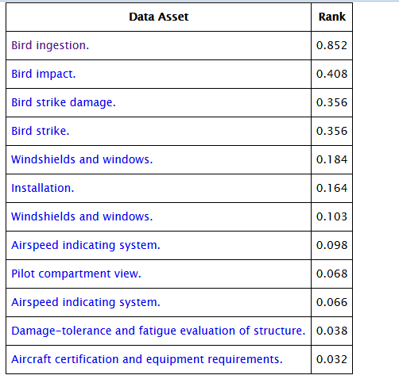
All 12 Bird Strike FARs, per CrOSS Ranking

Slide 8
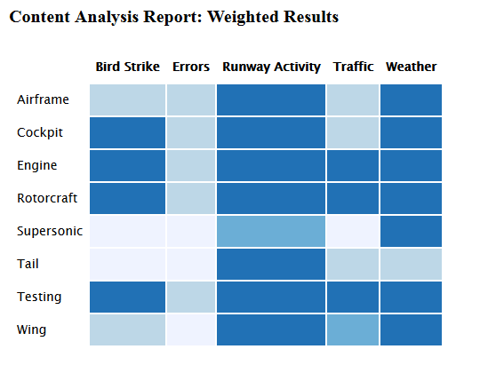
Crosswalk of FARs Using Aviation Topics

Slide 9
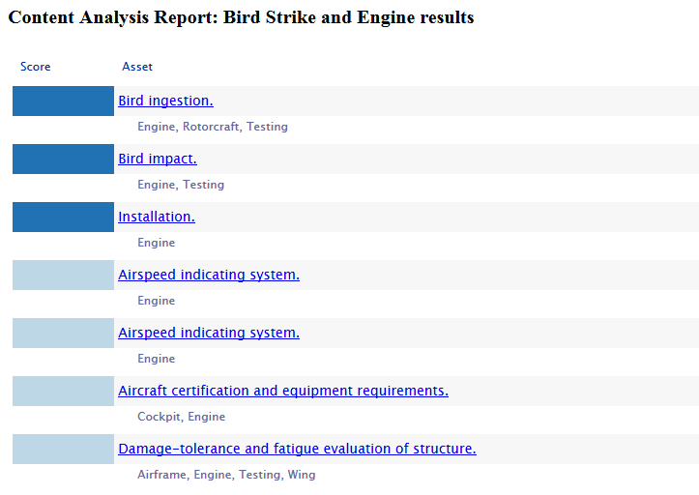
Ranked Individual FARs in Bird Strike + Engine Category

Slide 10
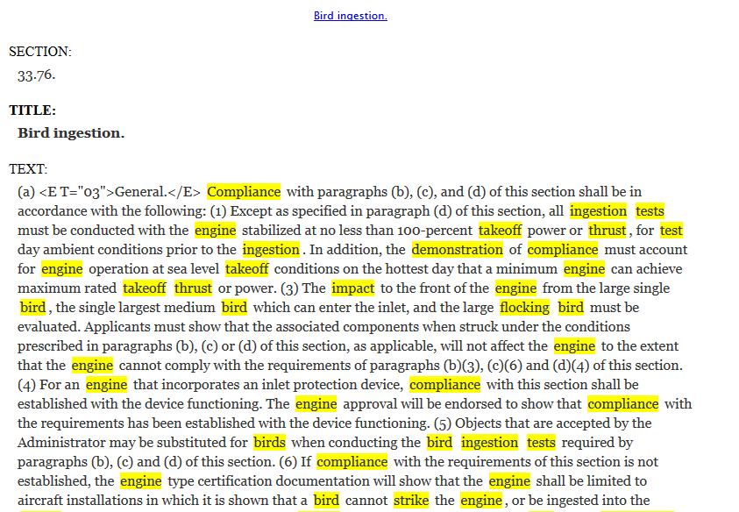
Top FAR Highlighted with Evidence

Slide 11
Some Technical Details

Slide 12
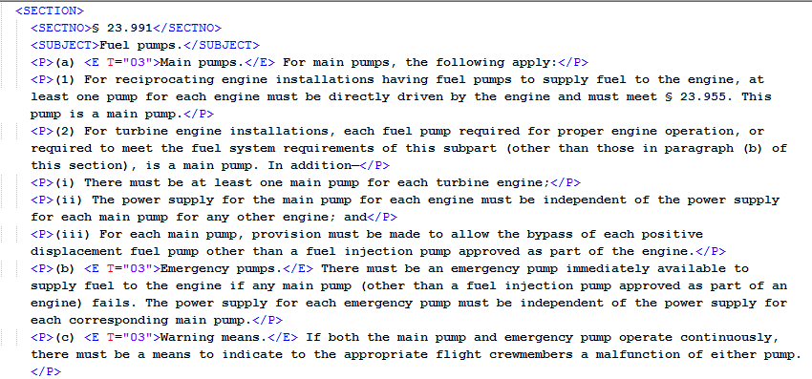
Original FAR Data Source
5 XML Batch Files
  2-5 Megabytes each
  19.5 Megabytes total
  Many non-FAR Meta-sections (TOC, Usage, Appendices)

Slide 13
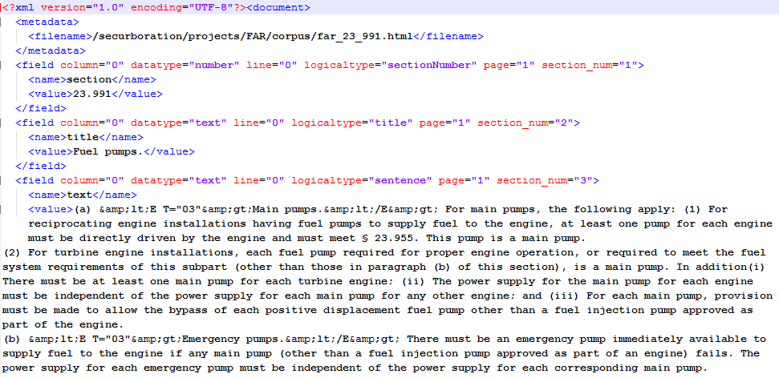
FAR Data Source Conversion
6530 Individual FAR Sections
  HTML version
  Securboration Document Model version

Slide 14
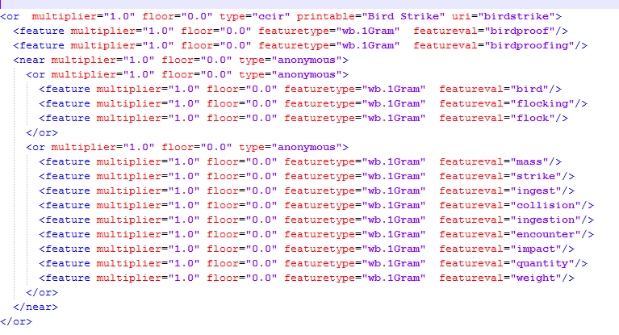
Ontology-Based Query Language
Better-than-keyword queries using natural language expressions and ontology relations to support aviation Topics

Slide 15
Validation

Slide 16
Validation Against Human Research, FAR Portal Site
CrOSS: Semantic Query for Bird Strike
Human: Text Editor Query for “Bird Strike” in Original XML
Portal: Keyword Query for “Bird Strike”
Cross
  Precision: 100%
  Recall: 100%
Human
  Precision: 100%
  Recall: 17%
Portal
  Precision: 100%
  Recall: 25%
FAR | CrOSS | Human | Portal Search
23.1323 | Y | N | N
23.775 | Y | N | N
23.901 | Y | N | N
25.1323 | Y | N | N
25.571 | Y | N | N
25.631 | Y | Y | Y
25.773 | Y | N | N
25.775 | Y | N | N
29.631 | Y | Y | Y
33.76 | Y | N | Y
35.36 | Y | N | N
121.157 | Y | N | N
A119-1 | N | N | N
NOTE: This section is about agricultural use of civil aircraft in bird chasing

Slide 17
Validation Against Human Research, FAR Portal Site
CrOSS: Semantic Query for Bird Strike
Human: Text Editor Query for “Bird” in Original XML
Portal: Keyword Query for “Bird”
Cross
  Precision: 100%
  Recall: 100%
Human
  Precision: 92%
  Recall: 100%
Portal
  Precision: 92%
  Recall: 92%
FAR | CrOSS | Human | Portal Search
23.1323 | Y | Y | Y
23.775 | Y | Y | Y
23.901 | Y | Y | Y
25.1323 | Y | Y | Y
25.571 | Y | Y | Y
25.631 | Y | Y | Y
25.773 | Y | Y | Y
25.775 | Y | Y | Y
29.631 | Y | Y | Y
33.76 | Y | Y | Y
35.36 | Y | Y | Y
121.157 | Y | Y | N
A119-1 | N | Y | Y

Slide 18
What Happens When Wildlife Strikes?
Bird Strikes are only a part of the problem
FAA Wildlife Strike Database allows for coyotes, insects, etc.
Update CrOSS semantic definition from bird strikes to wildlife strikes
  17 results
Keyword query FAR portal ‘wildlife strike’
  2 results
Keyword query FAR portal ‘wildlife’
  7 results

Slide 19
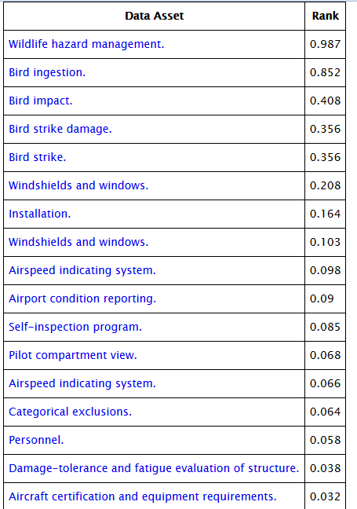
All 17 Wildlife Strike FARs, per CrOSS Ranking

Slide 20
Wildlife Validation Against FAR Portal Site
FAR | CrOSS | Portal Search
21.25 | N | Y
23.1323 | Y | N
23.775 | Y | N
23.901 | Y | N
25.1323 | Y | N
25.571 | Y | N
25.631 | Y | N
25.773 | Y | N
25.775 | Y | N
29.631 | Y | N
33.76 | Y | N
35.36 | Y | N
121.157 | Y | N
139.203 | N | Y
139.303 | Y | Y
139.327 | Y | Y
139.337 | Y | Y
139.339 | Y | Y
139.5 | N | Y
1216.304 | Y | N
A119-1 | N | N
CrOSS: Semantic Query for Wildlife Strike
Portal: Keyword Query for “Wildlife”
Cross
  Precision: 94%
  Recall: 89%
Portal
  Precision: 86%
  Recall: 33%
NOTE: These sections are about human impact on wildlife

Slide 21
Conclusions

Slide 22
Some Remarks
CrOSS is implemented as a standing query
  Standing queries are more stable, easier to re-use in multiple information requirement contexts
“Bird Strike” is a query written at the same level as the language of the FARs
  FARs do not specify differences between eagle strikes and swallow strikes
“Wildlife Strike” is a query written at a slightly more general level than most FARs
  Bird strikes count as wildlife strikes, but keyword search engines can’t know this

Slide 23
Conclusions
CrOSS Semantic search and navigation can significantly improve situational awareness and decision making
  Improve incident response turnaround time
  Alignment of regulatory content to complex information requirements
  Ability to deal with general concepts such as ‘wildlife’ and ‘weather’
  Ability to put information in context based on evidence

Slide 24
Use Case 2: TCDS
Need to analyze 5 pieces of data found in the TCDS document repository
  TCDS number
  Model and series
  Maximum Takeoff Weight
  Maximum Structural Cruising Speed
  Number of seats
No database with this information exists
  All information in web-hosted PDF files
  Arbitrary number of models/series in each PDF
  Arbitrary amount of desired information available in each PDF

Slide 25
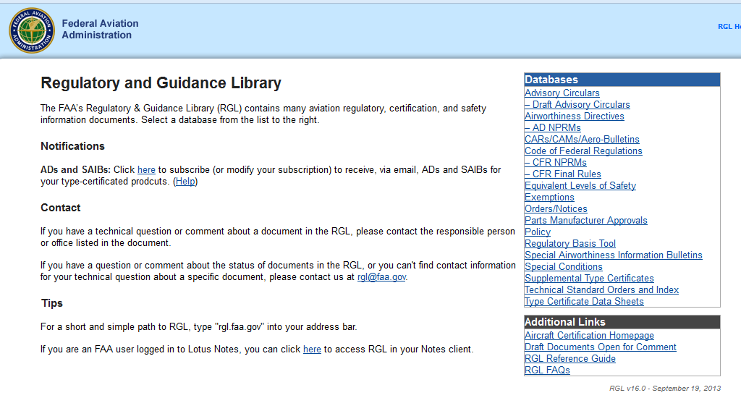
Authoritative Data Source

Slide 26
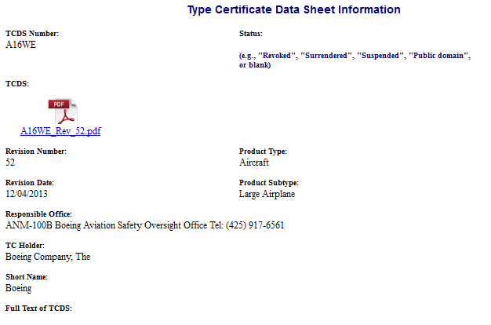
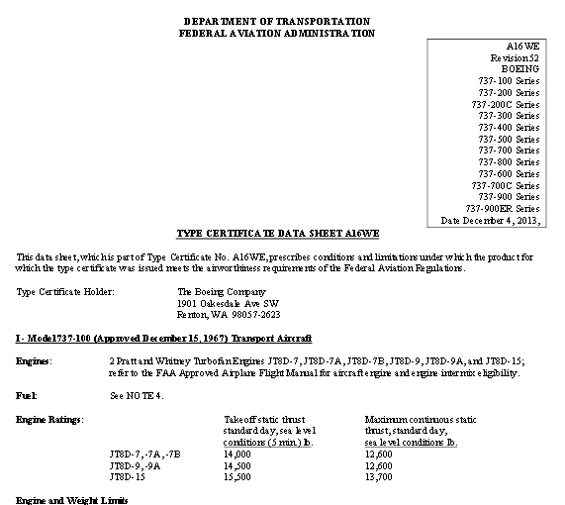
Locating a TCDS

Slide 27
TCDS PDF Document Characteristics
PDF URL patterns cannot be predicted from TCDS name
  /1a7.PDF
  /1A8_Rev_35.pdf
  /1E10%20Rev%2024.pdf
  /ATTZEDHU/ATC40.pdf
  /E00054EN%20Rev%208.pdf
Inconsistent Case
Arbitrary Subfolders
Inconsistent Revision Numbering

Slide 28
Dataset Harvesting Approach
Received 3 lists of TCDS Information Page URLs
Due to PDF naming inconsistencies, could not predict URLs to PDF TCDS source documents from the Information Page URLs
Instrumented Web Crawler to download the information page, find the link to the actual PDF(s) and download it locally

Slide 29
Dataset Harvesting Results
Harvested 2030 information pages to identify 2032 URLs leading to PDF TCDS source documents
  2 Word Documents
  1 TCDS information page without a link to any source document
  5 information pages had multiple links
Downloaded 2030 PDF files
  2 PDF URLs unavailable

Slide 30
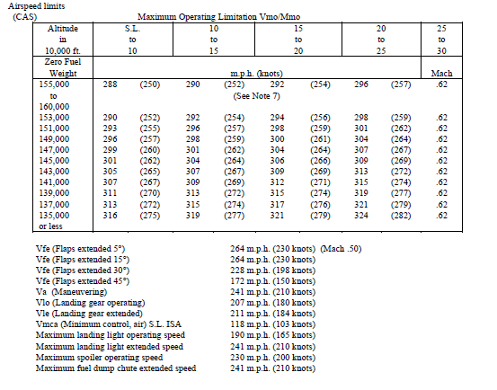
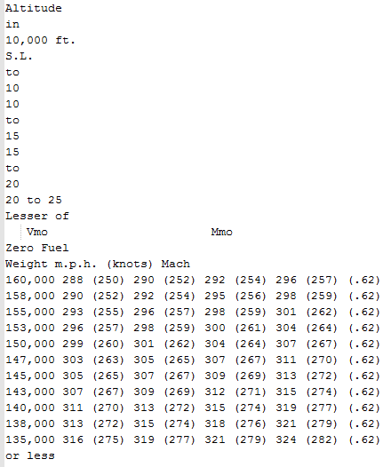
Extraction Results
Typical PDF Defects
Th is da ta shee t , wh ich i s pa r t o f Type Cer t i f i ca te No . A21CE, p resc r ibes cond i t i ons and l im i ta t i ons under
wh ich the p roduc t fo r the wh ich t ype ce r t i f i ca te was i ssued mee ts the a i rwor th iness requ i remen ts o f t he
Federa l Av ia t i on Regu la t i ons .
converts to text

Slide 31
Extraction Results
TCDS Code
  File name
    Eliminate “_Rev_#”
    Well-behaved (some file names like ATT2RSZ4_408_429_610_754_802_809_817_843)
  Regular expression search over TCDS text
    Aircraft Specification - 156
    Type Certificate Data Sheet - 1311
    TCDS – 1106
  Many case variants

Slide 32
Extraction Results
Models/Series
  Regular expression searches over TCDS text
  Ambiguity on AlphaNumeric sequences: What is “EA347?”
    Location may be important
    Machine learning for extraction requires significant marked-up ground truth

Slide 33
Extraction Results
Maximum Takeoff Weight (MTOW)
  Regular expression searches over TCDS text
  Maximum Takeoff Thrust also measured in pounds
  Tabular parsing necessary for full coverage – very difficult to do accurately
  For multi-model TCDS, which weight corresponds to which model?
  Many configurations have different MTOWs

Slide 34
Extraction Results
Maximum Structural Cruising Speed
  Regular expression searches over TCDS text
  Tabular parsing necessary for full coverage – very difficult to do accurately
  For multi-model TCDS, which speed corresponds to which model?

Slide 35
Extraction Results
Seating Capacity
  Regular expression searches over TCDS text
  Tabular parsing necessary for full coverage – very difficult to do accurately
  For multi-model TCDS, which seating corresponds to which model?

Slide 36
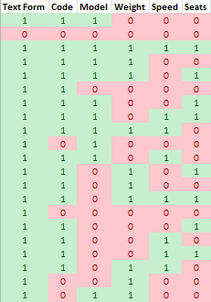
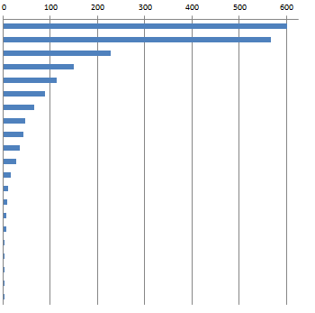
Extraction Completeness
Number of TCDS Matching Pattern
1 = Has Feature; 0 = Lacking Feature

Slide 37
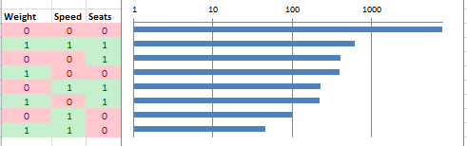
Extraction Detail
Desired Effect is to have Takeoff Weight, Seating Capacity and Cruising Speed associated with specific models
  Many TCDS have model-specific sections
  Attributes found within these sections can be assumed to pertain to the models named therein
Number of Models with Associated Data
1 = Has Feature; 0 = Lacking Feature

Slide 38
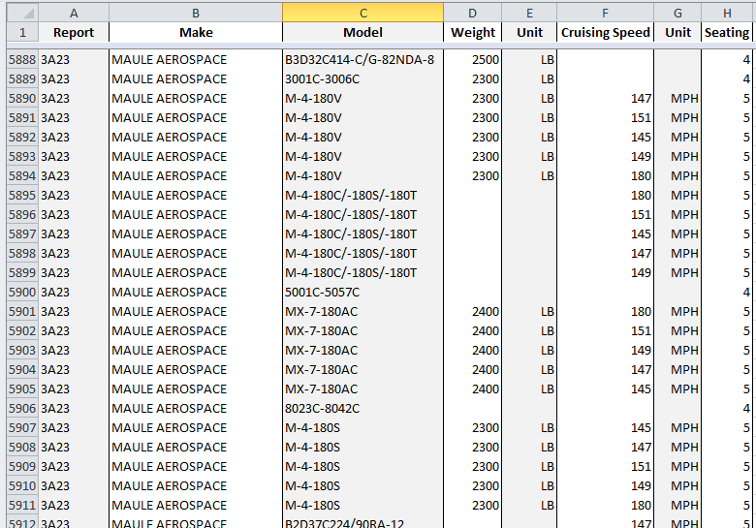
Model Data Results

Slide 39
Use Case 3: CrOSS Identifies Weather Requirements in CONOPS
Critical Information Requirement
  “What weather requirements are present in Inter-Agency Concept of Operations (CONOPS) documentation?”
Dataset Harvesting
  4700+ pages of CONOPS documents from FAA, ICAO, DoD, NASA, NOAA, MITRE, EuroControl, etc.
Domain Modeling
  Weather
  NextGen EA
  Requirements

Slide 40
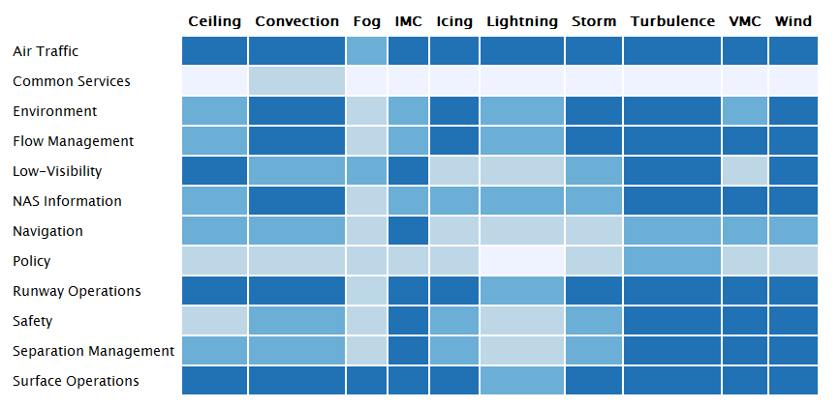
CrOSS Organizes Aviation-Impacting Weather and Aviation Services
56 FAA-Authored CONOPS/ConUse Documents, 2006-2014

Slide 41
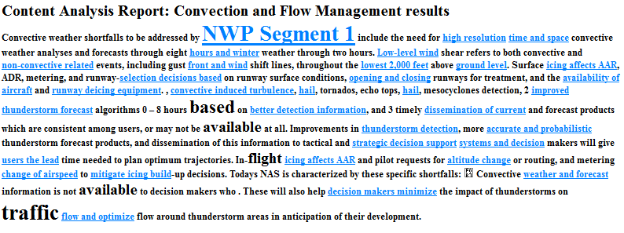
CrOSS Automatically Summarizes Top Documents
Notes:
DRM = Departure Reservoir Management; TMI = Traffic Management Initiative

Slide 42
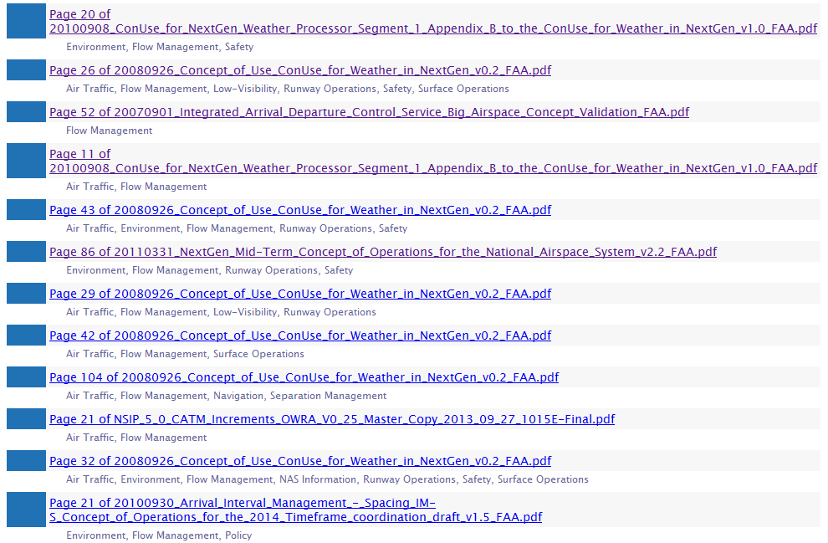
CrOSS Ranks CONOPS Pages by Weather Requirement Density

Slide 43
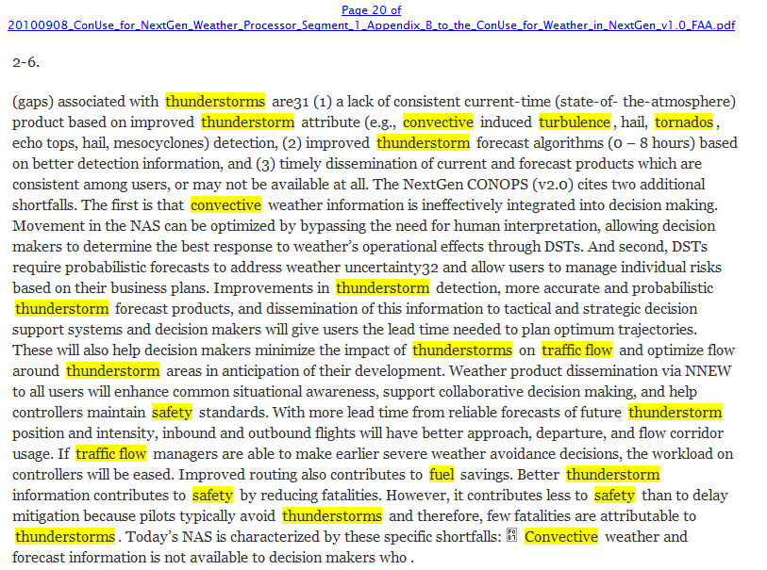
CrOSS Highlights CONOPS Content with Relevant Vocabulary
Requirements:
“Better thunderstorm information”
“Improvements in thunderstorm detection”
“dissemination of this information”
“more lead time from reliable forecasts”
Notes:
Add pop-up with 1 big font sentence

Slide 44
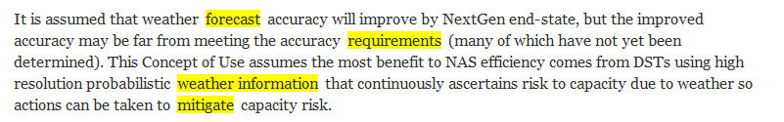
From ConUse for Weather in NextGen
Very typical statement throughout CONOPS/ConUse documents
Weather requirements must be interpreted through indirect language
Notes:
Add pop-up with 1 big font sentence

Slide 45
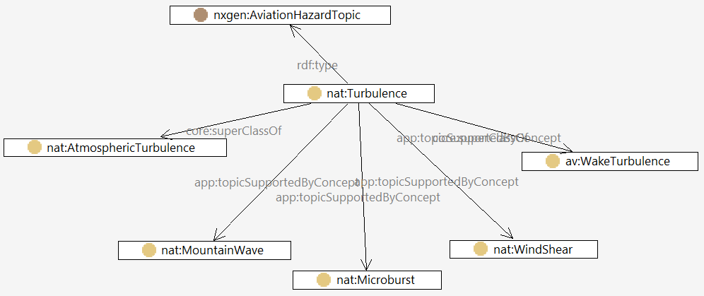
CrOSS Uses Domain Models to Analyze Text

Slide 46
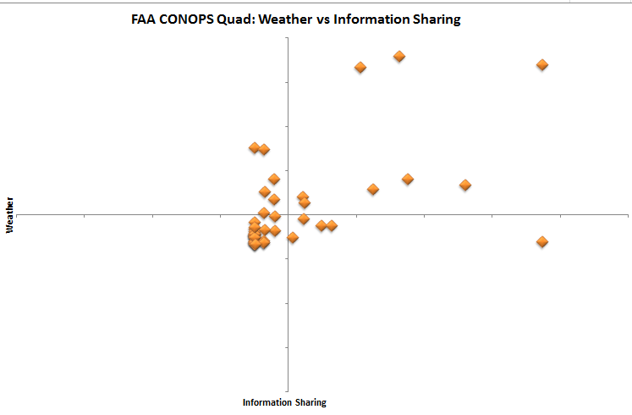
CrOSS Organizes CONOPS in Magic Quadrant Style
Aeronautical Information Management CONOPS
NextGen Weather ConUse
Ground-Based Augmentation System CONOPS
FAA/DoD Natural Environmental Parameters
56 FAA-Authored CONOPS/ConUse Documents, 2006-2014

Slide 47
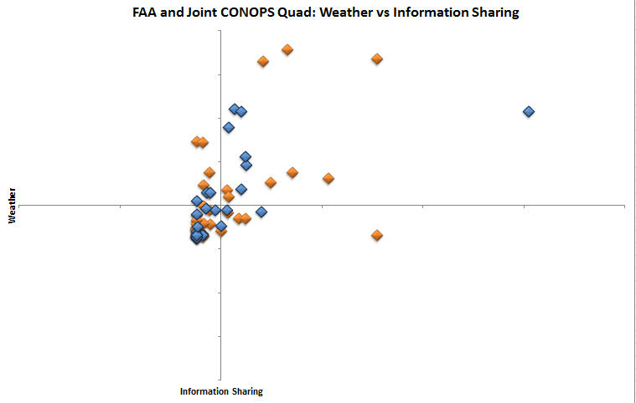
CrOSS Allows Multiple Dataset Comparison/Alignment
JPDO Net-Centric Operations CONOPS
NextGen Network-Enabled Weather CONOPS
MITRE Communication, Navigation, Surveillance Air Traffic Management
56 FAA-Authored CONOPS/ConUse Documents, 2006-2014
27 Joint Community CONOPS, 2006-2014

Slide 48
CrOSS Relies on Knowledge Representation
Many FAA, USG and Int’l taxonomy efforts
Ontology
Few ontology efforts
Near zero operational employment
Taxonomy
“psychometrics”
Thesaurus
CrOSS represents an IOC for both R&D and Operational use
“metering”
“traffic”
“UAS”
“RPV”
“icing”
“icing”
“traffic”
“psychometrics”
Vocabulary
“RPV”
“metering”
“UAS”

Slide 49
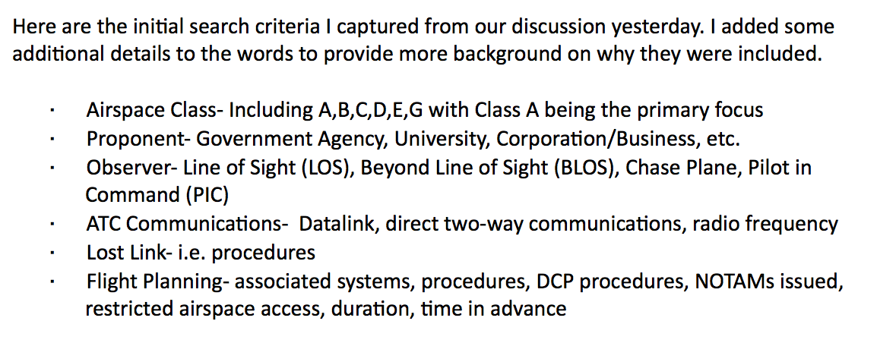
Bonus Use Case: COA Analysis
Extract data elements from COA collections:
Thus far, most time spent preparing data for processing

Slide 50
COA Linked Data
airspace
Class G Airspace
2009-WSA-120-COA
airspace
airspace
platform
proponent
AeroVironment Wasp
Department of Interior
Raven RQ 11B
platform
Department of Energy
proponent
Garin Quadcopter
proponent
platform
2012-ESA-67-COA
2010-WSA-44-COA

Slide 51
COA Linked Data
Extracted
Meta Data
2009-WSA-120-COA
airspace
Class G Airspace
proponent
Department of Interior
COA Documents
platform
mission
location
AeroVironment Wasp
Aircraft Characteristics
Law Enforcement
Tulare, California
Airport
Data
(future) Extracted
Meta Data
Weather
Data
External Data Sources

Slide 52
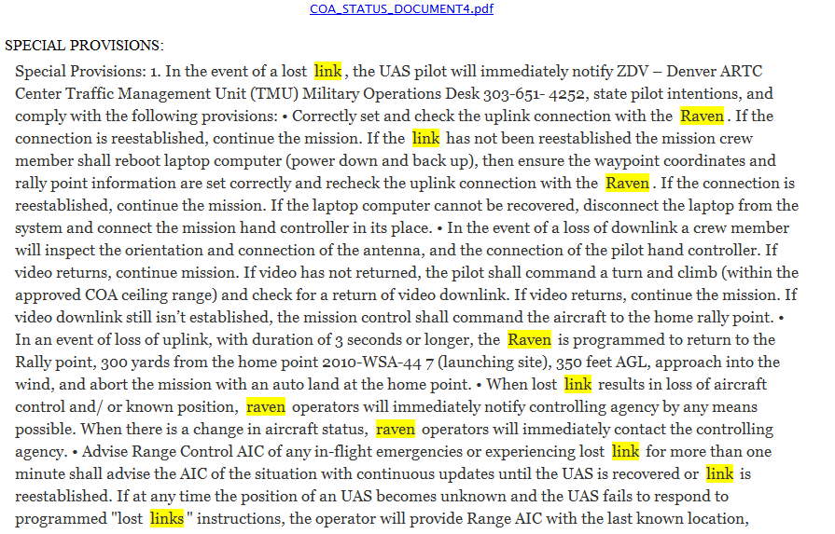
Special Provisions Linked Data
Special Provision
2009-WSA-120-COA
contains
contains
…
Mention1
mentions
found at
Feature
Offset1
tf-idf
Offset3
“0.00103”
Offset2
surface form
“link”
section
start
“1”
“1720”
length
“4”

Slide 53
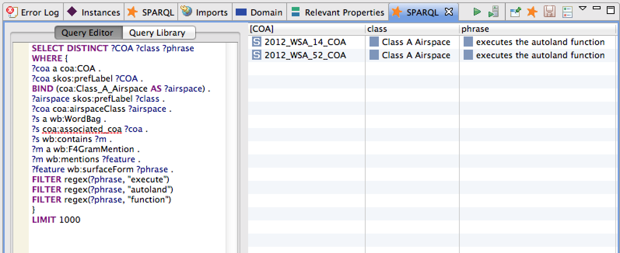
Example Query
Find me all the COAs that operate in Class A Airspace and mention “execute autoland function”

Slide 54
Ontology Stats
DOCUMENTS
DATA
Dataset: February 11, 2014 Release
Format: Batches of semi-structured PDF files
Source: UAS Initiative website (http://www.faa.gov/uas/public_operations/foia_responses/)
Total Number of Triples: 2,743,263
Asserted: 182,050
Inferred: 2,561,263

Slide 55
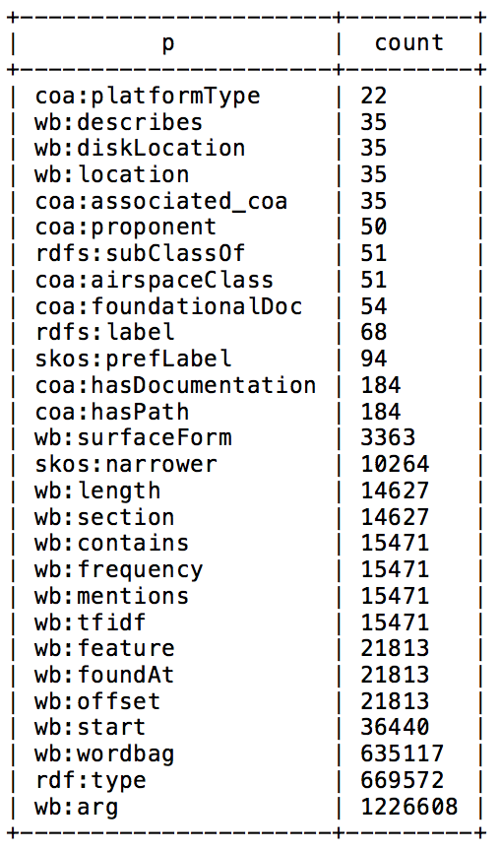
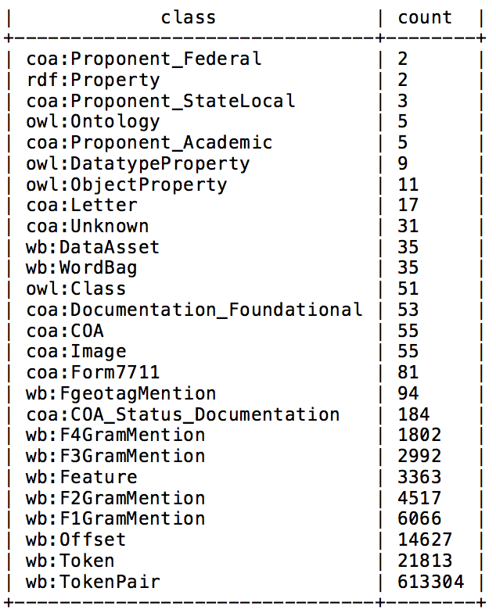
More Stats
Total number of instances of the class
Total number of triples using property

Slide 56
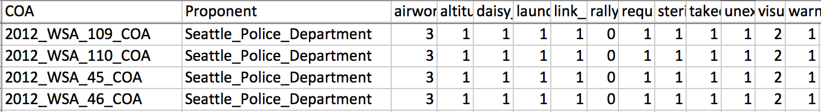
Clusters
airworthiness
altitude change
daisy chaining
launch
link orbit point
rally point
required communication
sterile cockpit
takeoff briefing
unexpected turn
visual observer
warning area airspace
A Dozen Common Keywords

Slide 57
Backups

