Slide 1
AIXM 5.1.1 scripts and plannning
AIXM CCB – Webex, 19 Dec 2013

Slide 2
[AIXM-132] Migration to Sparx EA
Sparx EA Draft EAP model updated (thanks for Hubert Lepori)
http://webprisme.cfmu.eurocontrol.int/aixmwiki/bin/download/Main/AIXM_5_1_UML_EA/AIXM5.1.1Draft0.3.eap
issue with some stereotypes that prevented the export scripts from running properly
The stereotypes <<DataType>> and <<CodeList>> are now used consistently (which is by the way compliant with the ISO19107 spelling)
New version of the EA Script (thanks for Hubert Lepori)
Attached in JIRA to issue AIXM-132
Script used in SESAR for AIXM and other XML schema generation, please ignore those functions, just use the AIXM one (see next slides)
New: XSLT script that corrects the order of associations
See next slides
First draft, further testing necessary

Slide 3
[AIXM-132] Migration to Sparx EA
This new version includes a number of property files that store textual key/value elements for different environment, including the AIXM environment. In particular, the file AIXMProperty (in package resources) contains for instance:
aixm_51_stereotype_codelist = CodeList aixm_51_stereotype_datatype = DataType aixm_51_stereotype_xsd_facet = XSDfacet aixm_51_stereotype_feature = feature

Slide 4
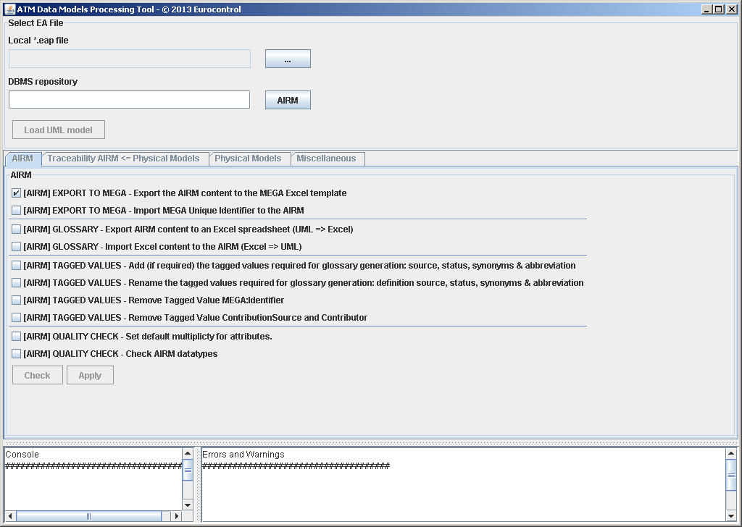
[AIXM-132] Migration to Sparx EA
Run the scripts
Make sure that
SSJavaCom.dll is in the Windows Path
eaapi.jar is in the CLASSPATH
Launch start.bat
Should see this window ->
Select AIXM eap file and
Load UML Model
See in Console
“Loading complete…”
See Physical Models tab

Slide 5
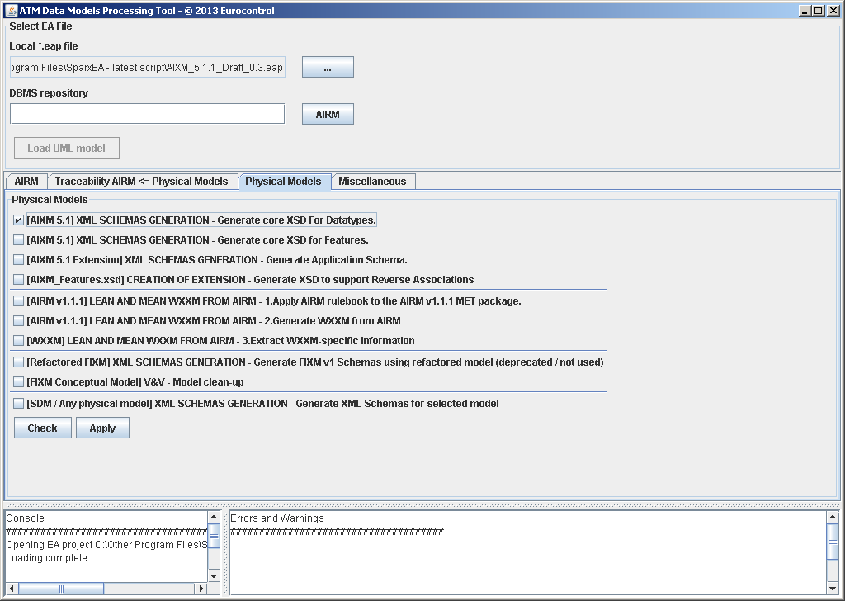
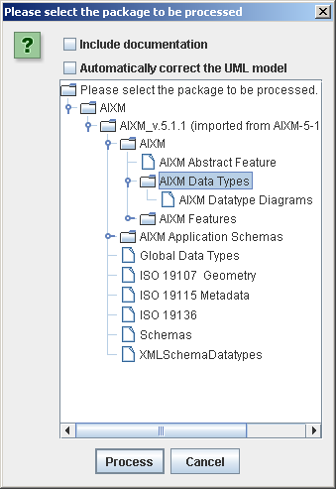
[AIXM-132] Migration to Sparx EA
Generate XSD for data types
When done:
Message “Done...” in Console
Resulting AIXM_DataTypes.xsd is in ‘output’ folder

Slide 6
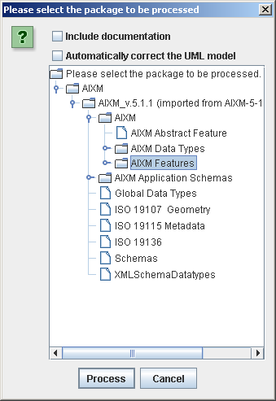
[AIXM-132] Migration to Sparx EA
Generate XSD for features
Select “…Generate core XSD for Features”
See the progress in Console
When done:
Message “Done...” in Console
Resulting AIXM_Features.xsd in ‘output’ folder
Known issues
“uom” mandatory instead of optional for some data types

Slide 7
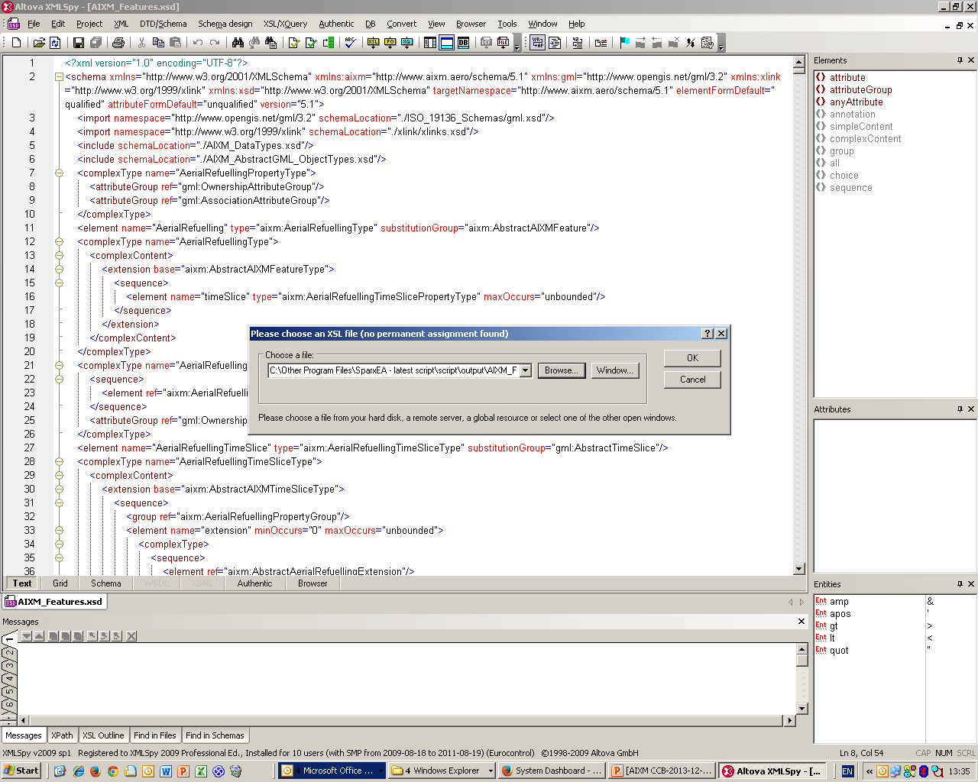
[AIXM-132] Migration to Sparx EA
Correct XSD for features – order of associations to be similar to previous version (where applicable)
Use AIXM_Features_Script.xsl
Here applied with XML Spy
Attention! Needs AIXM_Features-5.1.xsd in the same folder (the previous version “reference” XSD schema!)

Slide 8
[AIXM-132] Migration to Sparx EA
Next step – scripting support for extensions
EA script
Any voluntary to test the limits of existing scripts?
XSLT script
Any voluntary to test the limits of existing scripts?
Document migration process and the development of extensions directly in EA
Proposal – make your proposals using GoogleDocs
Anyone with the link can view/comment!
Interested to contribute/edit? -> please request access to the document directly in Google, using your Google ID

Slide 9
AIXm 5.1.1
Proposal – Secretariat (Eurocontrol and FAA) to start drafting formal change proposals by 20 January
Only for the issues identified at the ad-hoc CCB meeting as candidates for AIXM 5.1.1
A comment “candidate for 5.1.1 will be added today” to all these issues
Please review all existing issues and make eventual comments in JIRA

